Slide 1
A1 Network PCN
Data pack
August 2019

Slide 2
A1 Network PCN – summary
There are almost 40,150 people registered with A1 Network PCN, with a larger older population compared to the North Alliance, CCG and England. The population is estimated to increase by 21% between 2019 and 2031, one of the largest increases of any PCN within the CCG The PCN has a higher proportion of White British ethnic group when compared to the North Alliance, CCG and England Relative deprivation is lower in the PCN compared to the North Alliance, CCG and England. Approximately 9% of children and 9% of older people live in poverty. It is estimated that on average there are 380 births a year in the PCN. The PCN birth rate is similar to the North Alliance, but the percentage of low birth weight births is statistically significantly lower than the North Alliance It is estimated that both male and female life expectancy within the PCN is statistically significantly higher than the North Alliance, at 81.8 and 85.7 years respectively Recorded obesity in adults is statistically significantly lower than the North Alliance. It is estimated that 12.7% of adults smoke, which is statistically significantly lower than the North Alliance | Estimates of people reporting long-term activity-limiting illness and being in Good or Very Good health are statistically better than the averages for the North Alliance On average there are 293 deaths a year in the PCN, with around a third of these in people aged under 75 years The PCN has statistically significantly high recorded prevalence of coronary heart disease, hypertension, stroke, asthma and cancer compared to the North Alliance, which may be a reflection of the older population of the A1 Network Mortality rates within the A1 Network are generally statistically significantly better than the North Alliance averages

Slide 3
Demography

Slide 4
GP registered population
A1 Network PCN has a lower proportion of people aged 18 and under and higher proportion aged 65 and over compared with North Alliance, CCG and England. The population of A1 Network PCN is forecast to grow at a higher rate than the CCG as whole. Predicted growth of 9.0% between 2021 and 2026 and 8.1% between 2026 and 2031 is among the highest observed within C&P CCG.
Source: GP registered population, April 2019, NHS Digital. Population forecasts based on population distribution at ward level (Apr 19), Mid 2015 based population forecasts Cambridgeshire County Council
Age band | A1 Network PCN |  | North Alliance | Cambridgeshire and Peterborough CCG | England
 | Number | %
Total | 40,147 | 100.0% | 567,598 | 983,597 | 59,759,638
0-4 years | 1,841 | 4.6% | 5.9% | 5.4% | 5.5%
5-14 years | 4,482 | 11.2% | 12.6% | 11.7% | 11.8%
Under 18 years | 7,718 | 19.2% | 21.8% | 20.3% | 20.4%
16-64 years | 24,926 | 62.1% | 63.4% | 65.6% | 64.3%
65+ years | 8,428 | 21.0% | 16.9% | 16.3% | 17.4%
75+ years | 3,570 | 8.9% | 7.5% | 7.3% | 8.0%
85+ years | 903 | 2.2% | 2.2% | 2.2% | 2.3%
Population forecasts
PCN | 2019 | 2021 | 2026 | 2031 | 2036 | 2019 to 2021 |  | 2021 to 2026 |  | 2026 to 2031 |  | 2031 to 2036
 |  |  |  |  |  | Number | % | Number | % | Number | % | Number | %
A1 Network PCN | 40,147 | 41,498 | 45,251 | 48,901 | 51,426 | 1,351 | 3.4% | 3,753 | 9.0% | 3,650 | 8.1% | 2,525 | 5.2%
C&P CCG | 982,987 | 1,011,368 | 1,072,891 | 1,097,528 | 1,110,295 | 28,381 | 2.9% | 61,522 | 6.1% | 24,637 | 2.3% | 12,767 | 1.2%

Slide 5
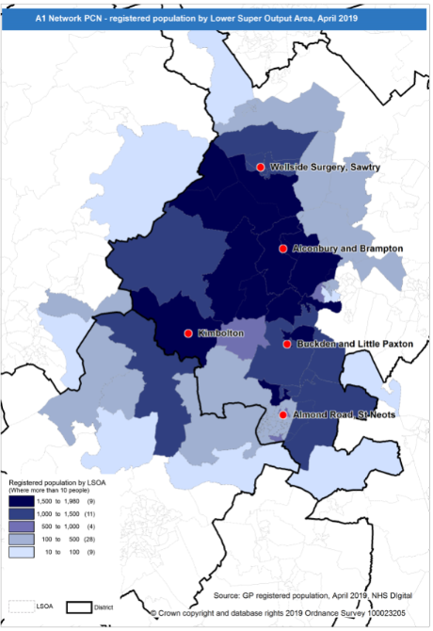
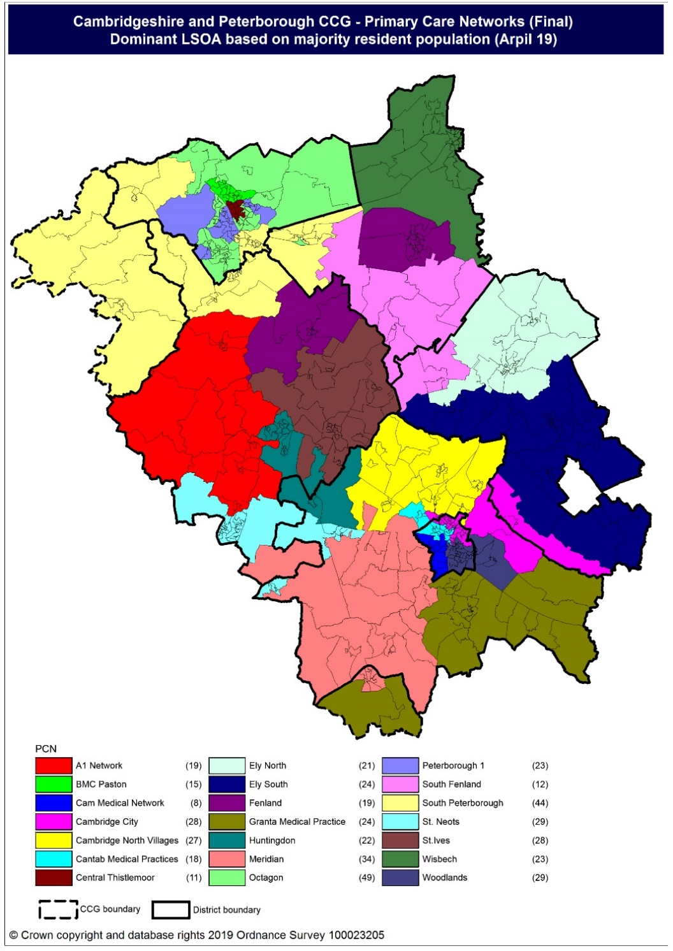
Population distribution
Source: GP registered population data by Lower Super Output Area, April 19, NHS Digital
Population
distribution
PCN dominant
population

Slide 6
Ethnicity
A1 Network PCN has a higher proportion of population from the White British ethnic group and lower proportions from all other ethnic groups compared to the North Alliance, CCG and England averages.
Source: Census 2011 data applied to GP registered population using Census 2011 ethnic group proportions; England data from NOMIS (patients registered at a GP Practice by LSOA, July 2018, NHS Digital)
PCN | White British | White Other | Mixed | Black | Asian: Indian/ Bangladeshi/ Pakistani | Asian: Chinese/Other | Other
A1 Network PCN | 91.2% | 4.8% | 1.4% | 0.8% | 0.7% | 0.8% | 0.2%
North Alliance | 80.7% | 8.7% | 1.9% | 1.4% | 5.0% | 1.7% | 0.5%
Cambridgeshire and Peterborough CCG | 80.0% | 9.5% | 2.1% | 1.3% | 4.1% | 2.4% | 0.7%
England | 79.8% | 5.7% | 2.3% | 3.5% | 5.6% | 2.3% | 1.0%

Slide 7
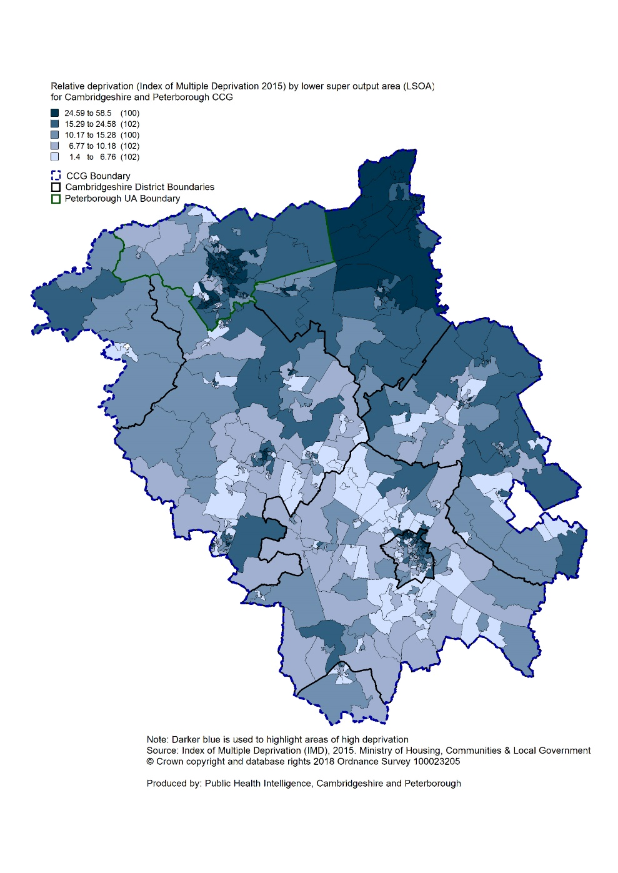
Deprivation
Relative deprivation is lower in A1 Network PCN and each of its constituent practices when compared to the North Alliance, CCG and England. Approximately 9% of children and 9% of older people live in income deprived households in A1 Network PCN; lower than the averages for North Alliance, CCG and England.
Source: C&P PHI derived from Indices of Multiple Deprivation 2015, DCLG and GP registered population data for July 2018. Practice data from PHE Fingertips.
 | Index of Multiple Deprivation | Income Affecting Children Index | Income Affecting Older People Index
Alconbury Surgery | 8.0 | 6.6% | 7.9%
Almond Road Surgery | 13.6 | 14.9% | 10.8%
Buckden Surgery | 8.0 | 7.9% | 7.2%
Kimbolton Medical Centre | 12.0 | 8.2% | 6.4%
Wellside Surgery | 10.5 | 9.5% | 10.3%
A1 Network PCN | 10.1 | 9.2% | 8.5%
North Alliance | 21.6 | 18.9% | 16.5%
C&P CCG | 17.2 | 15.4% | 14.3%
England | 21.8 | 19.9% | 16.2%
Index of Multiple Deprivation, 2015, by ward

Slide 8
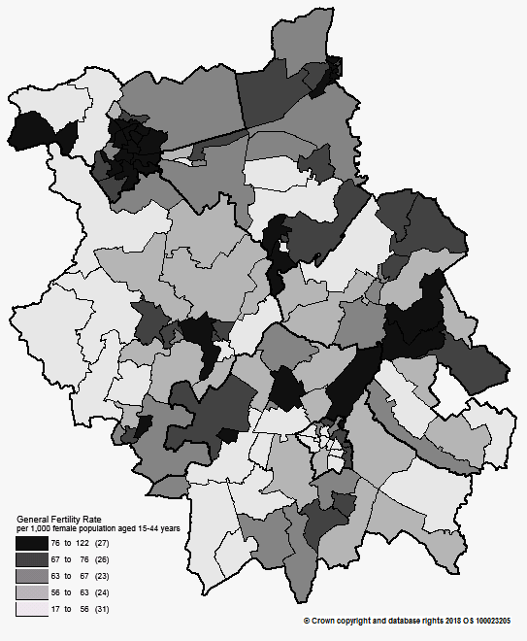
Births and Fertility
The birth rate for A1 Network PCN is statistically similar to the North Alliance and the low birth weight proportion within the PCN is statistically significantly lower than the North Alliance average.
Note: Relates to Cambridgeshire and Peterborough residents only Source: C&P PHI based on NHS Digital Civil Registration Data, 2014-2016 and patients registered at a GP Practice by LSOA, July 2018, NHS Digital (benchmark = North Alliance)
Birth rates by ward
 | Estimated
 | Number of live births (2014-2016) | Birth rate per 1,000 female population aged 15 to 44 years | Low birth weight births (under 2,500g)
A1 Network PCN | 1,138 | 63.1 | 0.4%
North Alliance | 19,756 | 65.8 | 6.8%
Cambridgeshire and Peterborough CCG | 31,348 | 58.2 | 6.5%
England | 1,989,052 | 62.4 | 7.4%

Slide 9
Life expectancy
Male and female life expectancy in A1 Network PCN are statistically significantly higher than both North Alliance and CCG values.
Source: C&P PHI based, derived from NHS Digital Civil Registration data and GP registered population data (benchmark = North Alliance), 2013 – 2017
 | Males (years) | Females (years)
A1 Network PCN | 81.8 | 85.7
North Alliance | 80.5 | 83.7
Cambridgeshire and Peterborough CCG | 81.2 | 84.3

Slide 10
Risk factors

Slide 11
Risk factors
Recorded prevalence of obesity is statistically significantly lower in A1 Network PCN compared to the average for North Alliance. Estimated smoking prevalence is also statistically significantly lower in A1 Network PCN compared to the average for North Alliance.
Source: Obesity - C&P PHI derived from NHS Digital QOF data for 2017/18 (benchmark = North Alliance) Estimated smoking - C&P PHI derived from the QOF based smoking prevalence estimate from the Public Health England (PHE) National General Practice Profiles at https://fingertips.phe.org.uk/profile/general-practice (benchmark = North Alliance)
 | Obesity |  | Estimated Smoking
 | Number | % | Number | %
A1 Network PCN | 2,468 | 7.7% | 4,259 | 12.7%
North Alliance | 44,121 | 10.1% | 90,367 | 19.8%
Cambridgeshire and Peterborough CCG | 65,496 | 8.5% | 136,105 | 17.0%
England | 4,530,447 | 9.8% | 8,301,429 | 17.2%

Slide 12
Self-reported limiting long-term illness and general health status
It is estimated that the proportion of people in the A1 Network PCN that reported that they had a long-term activity-limiting illness in the 2011 Census was statistically significantly lower than the North Alliance average. It is also estimated that the proportion of people in the A1 Network PCN that reported that they were in good or very good health in the 2011 Census was statistically significantly higher than the North Alliance average.
Source: C&P PHI from Census 2011, NOMIS and patients registered at a GP Practice by LSOA, July 2018, NHS Digital (benchmark = North Alliance)
 | Long-term activity-limiting illness | Good or very good health
A1 Network PCN | 14.6% | 85.1%
North Alliance | 16.7% | 81.9%
Cambridgeshire and Peterborough CCG | 15.5% | 83.6%
England | 17.6% | 81.4 %

Slide 13
Diseases

Slide 14
Mortality – all causes
There are on average 293 deaths a year in A1 Network PCN, approximately a third are in people aged under 75 years. At the A1 Network has statistically significantly lower directly age-standardised rates of all-age and under 75 mortality compared to the North Alliance; this is also the case for Alconbury Surgery and Kimbolton Medical Centre.
DASR = directly age standardised rate per 100,000 population Source: C&P PHI, from NHS Digital Civil Registration Data and NHS Digital GP registered population data, 2013-2017 (benchmark = North Alliance)
 | All ages |  | Under 75 year olds
 | Number | DASR per 100,000 | Number | DASR per 100,000
Alconbury Surgery | 353 | 743.8 | 121 | 253.3
Almond Road Surgery | 260 | 906.0 | 110 | 367.1
Buckden Surgery | 394 | 886.4 | 95 | 208.9
Kimbolton Medical Centre | 193 | 699.2 | 61 | 177.9
Wellside Surgery | 263 | 854.6 | 83 | 251.9
A1 Network PCN | 1,463 | 817.5 | 470 | 247.9
North Alliance | 21,171 | 949.8 | 6,793 | 311.9
Cambridgeshire and Peterborough CCG | 34,464 | 901.5 | 10,385 | 286.4

Slide 15
Circulatory disease
A1 Network PCN prevalence rates of CHD, hypertension and stroke are statistically significantly high compared to North Alliance. The data are not age-standardised and therefore this may partly be as a result of the PCN’s relatively older population. The all-age mortality rate from circulatory disease is statistically similar to the North Alliance and for under 75s only, the mortality rate is statistically significantly lower than the North Alliance.
Note: Prevalence data are not available by age i.e. it is not age weighted so differences may be explained by differing age structures DASR = Directly age standardised rate per 100,000 population Source: Prevalence (recorded) - C&P PHI from QOF, NHS Digital, 2017/18 (benchmark = North Alliance) Mortality - C&P PHI, from NHS Digital Civil Registration Data and NHS Digital GP registered population data, 2013-2017 (benchmark = North Alliance)
 | Prevalence |  |  |  |  |  |  | Mortality (circulatory)
 | Coronary heart disease |  | Hypertension |  | Stroke |  |  | All ages |  | Under 75 year olds
 | Number | % | Number | % | Number | % |  | Number | DASR per 100,000 | Number | DASR per 100,000
Alconbury Surgery | 361 | 3.7% | 1,525 | 15.6% | 199 | 2.0% |  | 100 | 212.2 | 24 | 48.8
Almond Road Surgery | 214 | 3.0% | 848 | 11.8% | 100 | 1.4% |  | 77 | 273.9 | 25 | 83.6
Buckden Surgery | 311 | 3.5% | 1,369 | 15.3% | 167 | 1.9% |  | 117 | 264.9 | 23 | 51.8
Kimbolton Medical Centre | 223 | 3.4% | 1,123 | 17.3% | 85 | 1.3% |  | 44 | 163.1 | 7 | 18.6
Wellside Surgery | 233 | 3.1% | 1,108 | 14.9% | 132 | 1.8% |  | 74 | 235.0 | 26 | 78.0
At Network PCN | 1,342 | 3.4% | 5,973 | 15.0% | 683 | 1.7% |  | 411 | 233.0 | 105 | 55.0
North Alliance | 16,999 | 3.0% | 77,171 | 13.8% | 8,908 | 1.6% |  | 5,344 | 241.0 | 1,519 | 70.4
C&P CCG | 26,602 | 2.8% | 122,348 | 12.6% | 14,132 | 1.5% |  | 9,004 | 236.7 | 2,288 | 63.9
England | 1,827,352 | 3.1% | 8,141,488 | 13.9% | 1,030,869 | 1.8% |  | Not available

Slide 16
Respiratory disease
Asthma prevalence is statistically significantly high in the A1 Network PCN compared to the North Alliance, whereas COPD prevalence is statistically similar. Directly age-standardised rates of mortality as a result of respiratory disease are statistically significantly lower in the A1 Network PCN than in the North Alliance for both all ages and under 75 years only.
Note: Prevalence data are not available by age i.e. it is not age weighted so differences may be explained by differing age structures DASR = Directly age standardised rate per 100,000 population Source: Prevalence (recorded) - C&P PHI from QOF, NHS Digital, 2017/18 (benchmark = North Alliance) Mortality - C&P PHI, from NHS Digital Civil Registration Data and NHS Digital GP registered population data, 2013-2017 (benchmark = North Alliance)
 | Prevalence |  |  |  |  | Mortality
 | Asthma |  | Chronic Obstructive Pulmonary Disease |  |  | All ages |  | Under 75 years
 | Number | % | Number | %
 |  |  |  |  |  | Number | DASR per 100,000 | Number | DASR per 100,000
Alconbury Surgery | 739 | 7.6% | 219 | 2.2% |  | 49 | 104.3 | 11 | 22.6
Almond Road Surgery | 301 | 4.2% | 161 | 2.2% |  | 37 | 133.3 | 13 | 44.9
Buckden Surgery | 628 | 7.0% | 173 | 1.9% |  | 45 | 103.7 | 2 | 3.7
Kimbolton Medical Centre | 461 | 7.1% | 88 | 1.4% |  | 21 | 72.5 | 7 | 21.0
Wellside Surgery | 497 | 6.7% | 140 | 1.9% |  | 40 | 135.6 | 3 | 9.2
A1 Network PCN | 2,626 | 6.6% | 781 | 2.0% |  | 191 | 110.1 | 36 | 19.0
North Alliance | 33,050 | 5.9% | 10,952 | 2.0% |  | 3,065 | 139.7 | 678 | 31.9
C&P CCG | 57,830 | 6.0% | 16,513 | 1.7% |  | 4,533 | 119.9 | 942 | 26.8
England | 3,463,893 | 5.9% | 1,113,417 | 1.9% |  | Not available

Slide 17
Long term conditions
Diabetes prevalence is statistically significantly low within the A1 Network compared to the North Alliance, whereas cancer prevalence is statistically significantly high. The A1 Network PCN has statistically significantly low directly age-standardised rates of mortality from cancer compared to the North Alliance for all ages and for under 75s only.
Note: Prevalence data are not available by age i.e. it is not age weighted so differences may be explained by differing age structures DASR = Directly age standardised rate per 100,000 population Source: Prevalence (recorded) - C&P PHI from QOF, NHS Digital, 2017/18 (benchmark = North Alliance) Mortality - C&P PHI, from NHS Digital Civil Registration Data and NHS Digital GP registered population data, 2013-2017 (benchmark = North Alliance)
 | Prevalence |  |  |  |  | Mortality - Cancer
 | Diabetes (17+ years) |  | Cancer |  |  | All ages |  | Under 75 year olds
 | Number | % | Number | % |  | Number | DASR per 100,000 | Number | DASR per 100,000
Alconbury Surgery | 493 | 6.2% | 364 | 3.7% |  | 115 | 235.0 | 59 | 122.3
Almond Road Surgery | 350 | 6.0% | 185 | 2.6% |  | 68 | 226.8 | 37 | 125.0
Buckden Surgery | 458 | 6.2% | 363 | 4.1% |  | 107 | 231.8 | 44 | 93.5
Kimbolton Medical Centre | 291 | 5.4% | 215 | 3.3% |  | 64 | 203.9 | 33 | 92.1
Wellside Surgery | 435 | 7.2% | 202 | 2.7% |  | 73 | 230.2 | 38 | 114.8
A1 Network PCN | 2,027 | 6.2% | 1,329 | 3.3% |  | 427 | 226.8 | 211 | 109.3
North Alliance | 30,953 | 7.0% | 14,854 | 2.7% |  | 6,093 | 269.7 | 2,807 | 130.1
C&P CCG | 46,573 | 6.0% | 25,700 | 2.7% |  | 9,902 | 259.5 | 4,411 | 123.2
England | 3,196,124 | 6.8% | 1,593,302 | 2.7% |  | Not available

Slide 18
Mental health
The A1 Network PCN has statistically significantly low prevalence of mental health disorders and registered patients with learning disabilities compared to the North Alliance and is statistically similar to the North Alliance with regards to depression and dementia prevalence. However, Alconbury Surgery and Almond Road Surgery have statistically significantly high depression and dementia prevalence compared to the North Alliance.
Note: Prevalence data are not available by age i.e. it is not age weighted so differences may be explained by differing age structures Source: Prevalence (recorded) - C&P PHI from QOF, NHS Digital, 2017/18 (benchmark = North Alliance) Mortality - C&P PHI, from NHS Digital Civil Registration Data and NHS Digital GP registered population data, 2013-2017 (benchmark = North Alliance)
 | Schizophrenia, bipolar affective disorder and other psychoses |  | Depression (18+ years) |  | Dementia |  | Learning disabilities
 | Number | % | Number | % | Number | % | Number | %
Alconbury Surgery | 43 | 0.4% | 893 | 11.4% | 92 | 0.9% | 41 | 0.4%
Almond Road Surgery | 65 | 0.9% | 749 | 13.0% | 70 | 1.0% | 68 | 0.9%
Buckden Surgery | 39 | 0.4% | 535 | 7.4% | 82 | 0.9% | 9 | 0.1%
Kimbolton Medical Centre | 28 | 0.4% | 447 | 8.4% | 39 | 0.6% | 9 | 0.1%
Wellside Surgery | 40 | 0.5% | 542 | 9.1% | 48 | 0.6% | 6 | 0.1%
A1 Network PCN | 215 | 0.5% | 3,166 | 9.8% | 331 | 0.8% | 133 | 0.3%
North Alliance | 4,096 | 0.7% | 41,730 | 9.5% | 4,094 | 0.7% | 2,675 | 0.5%
C&P CCG | 7,750 | 0.8% | 68,112 | 8.8% | 6,551 | 0.7% | 4,057 | 0.4%
England | 550,918 | 0.9% | 4,589,213 | 9.9% | 446,548 | 0.8% | 284,422 | 0.5%

