Slide 1

Joint Strategic Needs Assessment
Core Dataset 2018/19
District Summary : Huntingdonshire

Slide 2
Introduction
The Joint Strategic Needs Assessment Core Dataset
The purpose of Cambridgeshire and Peterborough Joint Strategic Needs Assessments (JSNA) is to identify local needs and views to support local strategy development and service planning. In order to understand whether we are achieving good health and care outcomes locally, it is useful to benchmark outcomes in the area against local and national averages and look at trends over time.
The Cambridgeshire and Peterborough JSNA Core dataset includes key information around the most important health indicators affecting the residents of Cambridgeshire and Peterborough.
This document - district summary for Cambridge
The full Cambridgeshire and Peterborough JSNA Core dataset is available online at http://cambridgeshireinsight.org.uk/jsna and www.peterborough.gov.uk/healthcare/public-health/JSNA.
This district summary provides some key extracts and information from the Cambridgeshire and Peterborough JSNA Core dataset, particularly focusing on issues for the Huntingdonshire district.
There are district summaries available for the other Cambridgeshire districts.
Throughout this district summary references are made under each figure/table highlighting its respective location in the JSNA CDS.
Statistical significance
Throughout this district summary comparisons made between district/county and England/benchmark have been made through the assessment of statistical significance. For each indicator value, 95% confidence interval are calculated to provide a measure of uncertainty around the calculated value.
If the confidence interval for the district/county value excludes the value for the benchmark (which is typically England), the difference between the district/county value and the benchmark is said to be ‘statistically significant’. The colour scheme (or ‘red-amber-green’ RAG rating) representing the statistical significance, and relevant benchmark, is located under each table.

Slide 3
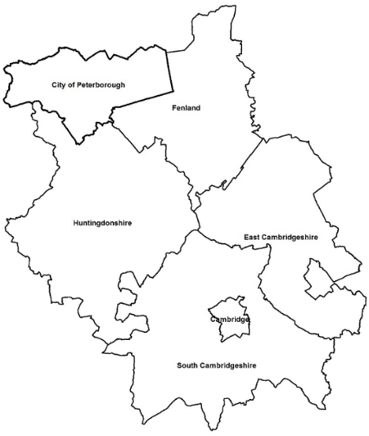
District overview
Huntingdonshire
In recent years Huntingdonshire has grown at a slower rate than Cambridgeshire overall. However, it is expected to have the largest absolute increases in population numbers by 2036 compared to the other Cambridgeshire districts.
Recently, natural change and migration have made an approximately equal contribution to population change in Huntingdonshire.
94.1% of Huntingdonshire’s population are recorded as from White: British or White: Other ethnic groups (89.5% and 4.6% respectively).
Huntingdonshire has fairly low levels of economic migration and is relatively rural.
Health outcomes in Huntingdonshire are broadly very good and often statistically significantly better than national averages.
Life expectancy for males and females is above the national average.
Levels of educational attainment in Huntingdonshire are similar to, and employment levels are better than, the national average.
Concerns in Huntingdonshire include alcohol abuse in young people, excess weight in adults, and the prevalence of respiratory disease.
The rate of inpatient admission episodes is statistically significantly worse than the Cambridgeshire average in Huntingdonshire.
Overall, socio-economic deprivation is lower in Huntingdonshire than in England, and compared to Cambridgeshire.

Slide 4
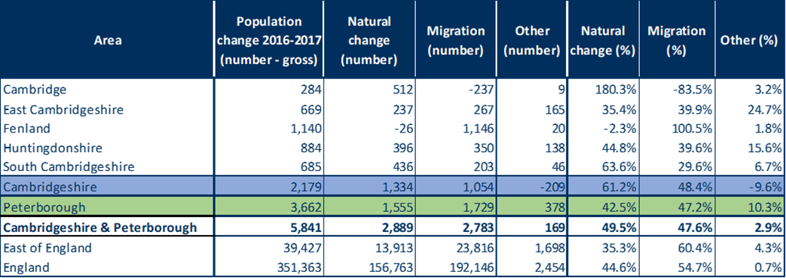
Current population and future forecasts
Population estimates and forecasts
The estimated population of Huntingdonshire in 2016 was 176,590. This is 20.8% of the Cambridgeshire & Peterborough total.
The population of Huntingdonshire is predicted to grow to 217,710 by 2036, an increase of 41,120 people (23.3%).
Huntingdonshire is predicted to have substantial growth between 2016-2036. It is expected to have the second-largest growth in absolute numbers of all the Cambridgeshire districts, increasing its population size by almost a quarter.
The population density of Huntingdonshire is similar to the other Cambridgeshire districts (excluding Cambridge); it is a relatively rural area.
Between 2016-2026 the older age groups, particularly the over 75 year age group, are expected to have most population growth across Cambridgeshire and Peterborough (data not shown - refer to Table 10 in full JSNA Core dataset for more information).
In Huntingdonshire, natural change accounts for slightly more of the population growth (44.8%), than migration (39.6%).
Note: These statements are based on the population estimates and projections of Cambridgeshire County Council Research Group. ONS also produce population estimates and forecasts using a different methodology. Please refer to the full JSNA Core dataset for more information.
Source: Cambridgeshire County Council Research Group. (Table 6)
Components of population change
Source: ONS Population estimates mid-2017. (Table 13)

Slide 5
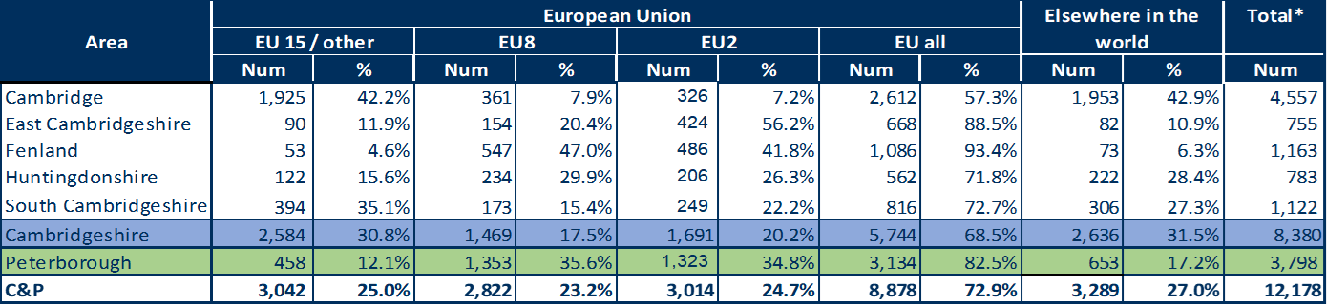
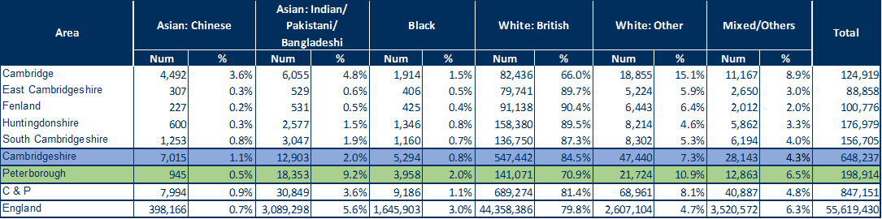
Population by ethnic group
Migration - National Insurance Number (NINO) Registrations
783 new NINO registrations were reported within Huntingdonshire. This represents 9.3% of the Cambridgeshire total.
Huntingdonshire has low levels of economic migration compared to other Cambridgeshire districts.
Huntingdonshire NINO registrations represent only 6.3% of Cambridgeshire and Peterborough’s EU NINO registrations (562/8,878) and 6.7% of non-EU NINO registrations (222/3,289).
NINO registrations October 2017 – September 2018
Note: EU15 member countries = EU members prior to the accession of 10 candidate countries on 1/5/2004; EU8 = the 10 accession countries; EU2 = those countries joining from 2007 (Bulgaria and Romania)
Source: Department for Work and Pensions. (Table 14 and Figure 18)
In most Cambridgeshire districts, including Huntingdonshire, the White British group comprises around 90% of the population.
Huntingdonshire has a lower proportion of people from other ethnic groups than Cambridgeshire and England.
Nationally, 5.6% of the population are from the Asian: Indian/Pakistani/Bangladeshi ethnic group, in Huntingdonshire these communities represent only 1.5% of the population.
Population estimates by broad ethnic group
Source: ONS, Census 2011, Table QS211EW applied to ONS Mid-2017 population estimates (Table 15)

Slide 6
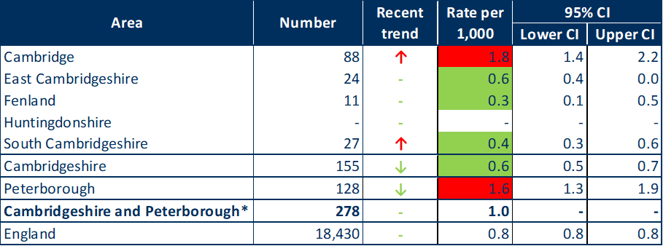
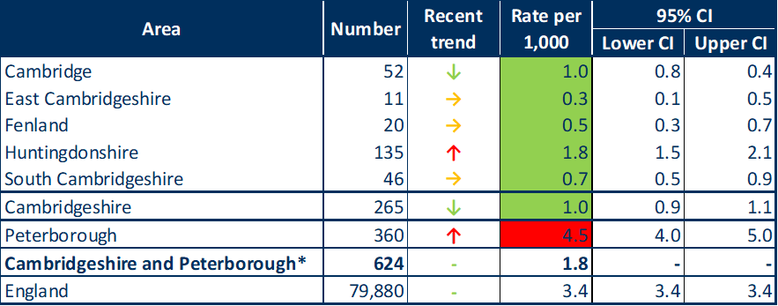


Other populations - Homelessness
Statutory homeless: eligible people not in priority need, 2017/18
Homelessness is associated with severe poverty, adverse health, educational and social outcomes, particularly for children.
‘Statutory homelessness – eligible homeless people not in priority need’ cohort, are majority single homeless people. Data figures are too small to assess the crude rate of this indicator in Huntingdonshire.
In Huntingdonshire the rate per 1,000 households of households in temporary accommodation is statistically significantly better than England.
At a district level, the rate is statistically significantly better than the national average for all districts. However, numerically Huntingdonshire is high in comparison to the other districts.
Huntingdonshire has an increasing recent trend of the rate of households in temporary accommodation.
Source: Ministry of Housing, Communities & Local Government (Table 19)
Statutory homeless: households in temporary accommodation, 2017/18
Value aggregated from all known lower geography values
Source: Ministry of Housing, Communities & Local Government (Table 20)

Slide 7
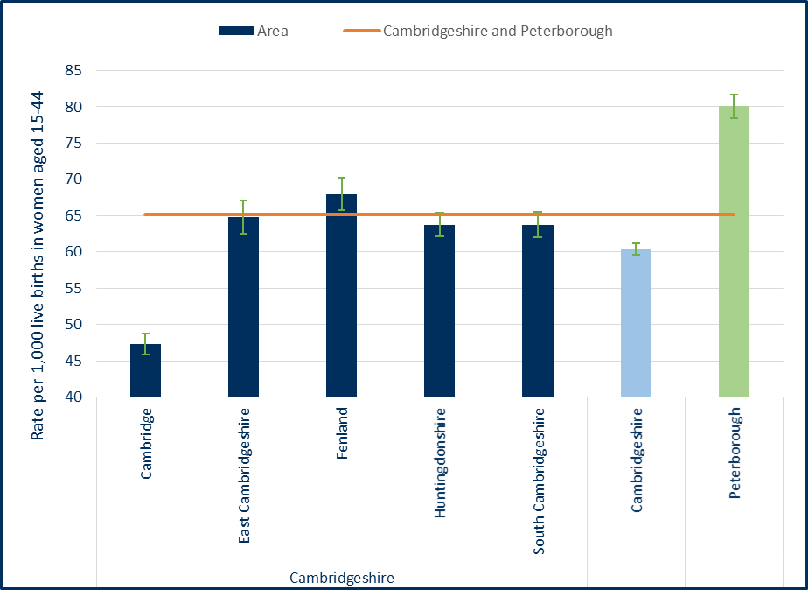
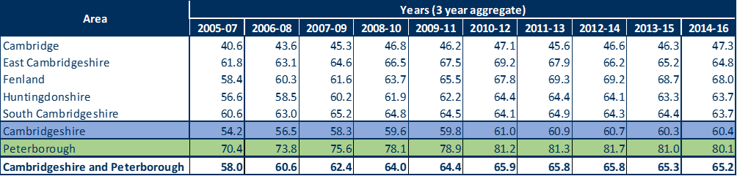
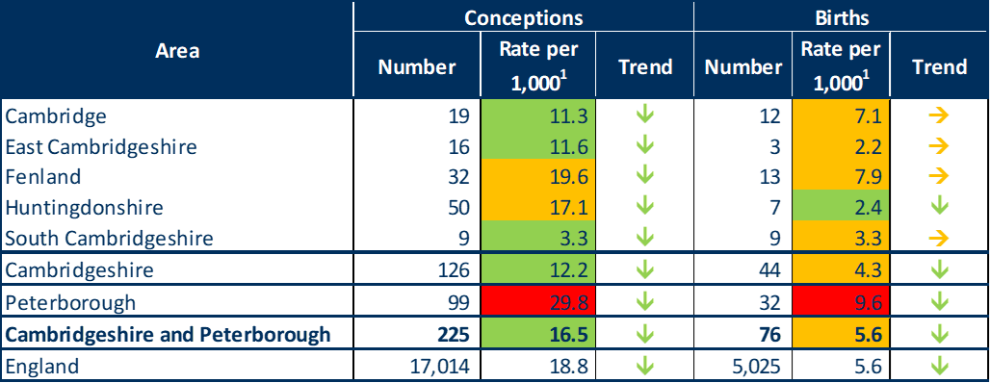

Birth rates and under 18 conceptions
Trend in general fertility rate (live birth rate per 1,000 women aged 15-44 years) by local authority of mother’s residence
Huntingdonshire has a slightly lower birth rate compared to the Cambridgeshire and Peterborough average.
Sources: ONS birth registrations, ONS mid-year population estimates (Figure 16 and Table 12)
2014-16 data only
Under 18 conceptions and birth rates, 2016
Compared to the county average, the Huntingdonshire birth rate (and all other districts excluding Cambridge) is statistically significantly higher (statistical significance not shown).
The fertility rate has increased between 2005-07 and 2014-16 for Huntingdonshire, and each of the Cambridgeshire districts. However, the rate in Huntingdonshire has seen a slight decline in recent years.
The rate of under 18 conception in Huntingdonshire is statistically similar to the England average and declining.
Birth rates to mothers aged under 18 are statistically significantly better in Huntingdonshire compared with the national average.
¹ per 1,000 females aged 15-17
Sources: Public Health England Public Health Outcomes Framework indicator 2.04, Sexual and Reproductive Health Profiles (ONS) (Table 49)

Slide 8
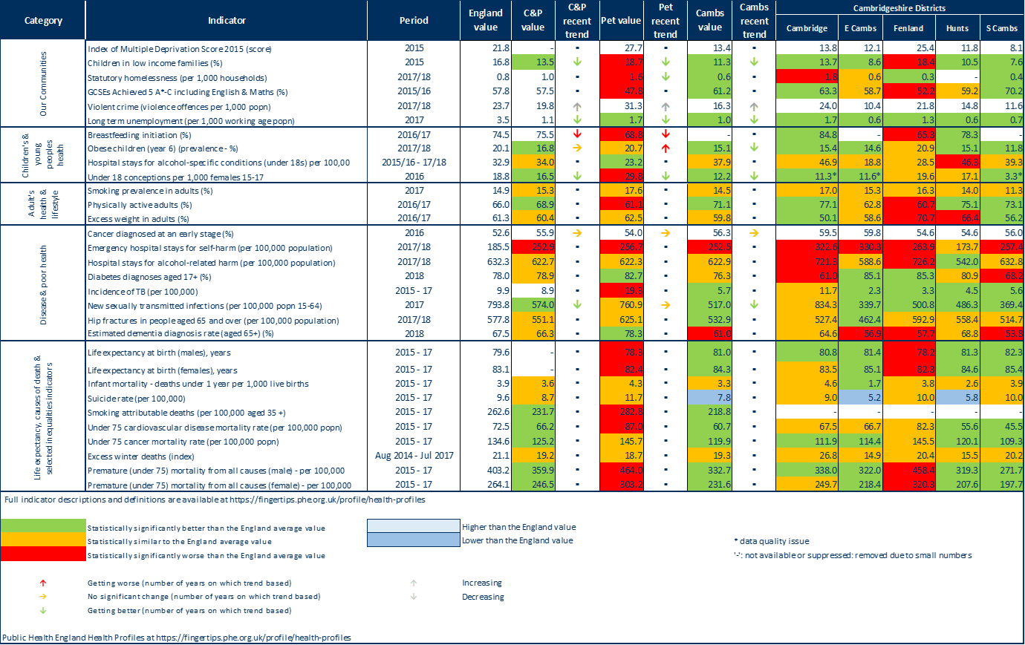
Public Health England summary health profile - at Nov 2018
Health summary
Huntingdonshire is statistically significantly better than, or statistically similar to, the England average for many of the key indicators in the health profile shown.
Children’s and young people’s health: Huntingdonshire has statistically significantly higher levels of hospital stays for alcohol-specific conditions (under 18s) per 100,000 than the national average.
Adult’s health and lifestyle: Huntingdonshire has statistically significantly higher levels of excess weight in adults than found nationally.
Source: Public Health England Health Profiles, November 2018

Slide 9
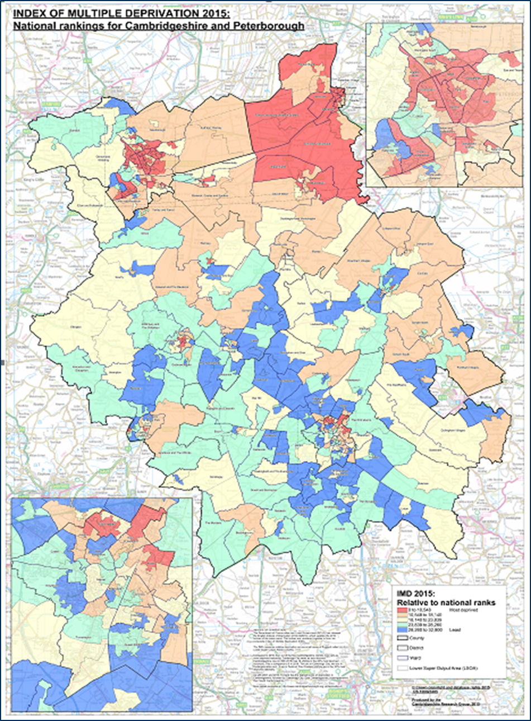
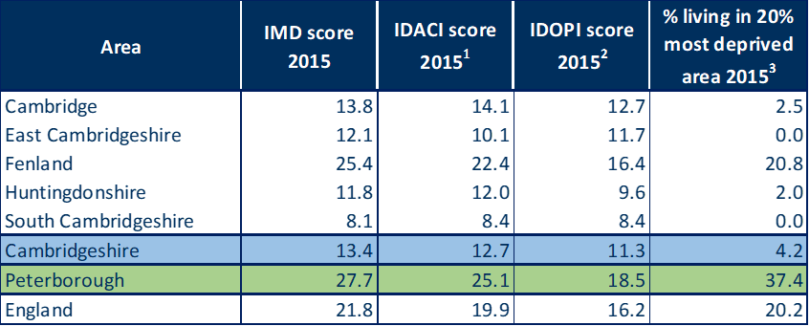
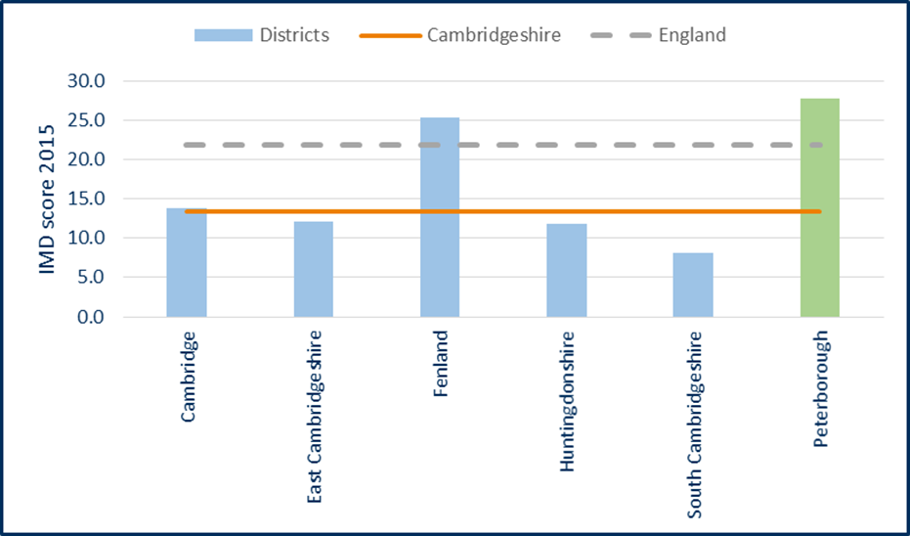
Local deprivation
Cambridgeshire as a whole has relatively less deprivation than England.
Huntingdonshire has some pockets of deprivation. Around 2.0% of LSOAs in Huntingdonshire are categorised as being within the most deprived 20% of areas nationally (IMD 2015).
Huntingdonshire has a lower (better) children’s deprivation score than Cambridgeshire, and this is below national average.
The older people’s deprivation score is lower (better) in Huntingdonshire than Cambridgeshire and most of the Cambridgeshire districts.
Huntingdon North ward is the only ward in Huntingdonshire categorised as the most deprived 20% of areas nationally.
Huntingdonshire has lower lower levels of relative overall deprivation as the county average.
Indices of deprivation:
Income Deprivation Affecting Children Index (IDACI); Income Deprivation Affecting Older People Index (IDAOPI); Indices of Deprivation (IMD)
Source: DCLG from PHE Mental Health and Wellbeing JSNA. (Table 22)
Overall deprivation (IMD 2015)
Source: DCLG from PHE Mental Health and Wellbeing JSNA. (Figure 22)
Source: Cambridgeshire County Council Research Group
(Figure 21)
Notes:
Notes:
1 - Income Deprivation Affecting Children Index (IDACI): Proportion of children aged 0–15 years living in income deprived households as a proportion of all children aged 0–15 years.
2 - Income Deprivation Affecting Older People Index (IDAOPI): Adults aged 60 or over living in income-deprived households as a percentage of all adults aged 60 or over.
3 - IMD 2015: % of people in an area living in 20% most deprived areas in England.

Slide 10
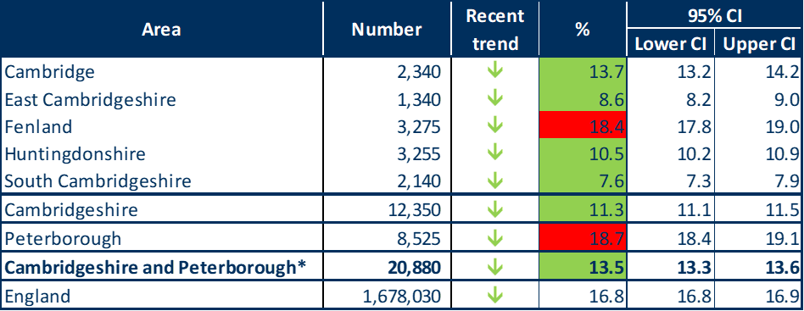
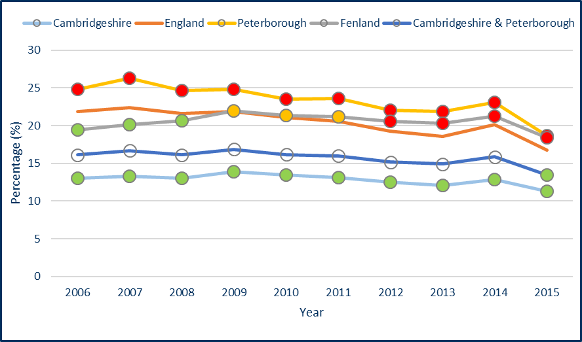
Child poverty
Children in low income families (aged under 16), 2015
Cambridgeshire’s percentage of children aged under 16 living in poverty is statistically significantly lower than England, with a decreasing recent trend.
The percentage in Huntingdonshire is statistically significantly lower than England with a declining recent trend.
An internal Cambridgeshire comparison shows that Cambridge and Fenland have statistically significantly worse child poverty rates than the Cambridgeshire average. The remaining districts have statistically significantly better rates than the Cambridgeshire rate.
Recent trend data 2006-2015 of the percentage of children in low income families shows that Cambridgeshire and Peterborough and Cambridgeshire have consistently lower levels than the England average.
* Value aggregated from all known lower geography values
Source: HMRC, from PHE Public Health Outcomes Framework (Table 24)
Children in low income families (aged under 16) – recent trends
Source: HMRC, from the PHE Public Health Outcomes Framework (Figure 27)

Slide 11
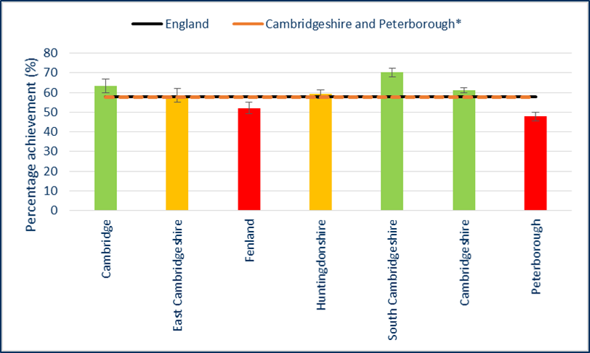
Child development and education attainment
School readiness: % of children achieving a good level of development at the end of reception
In Cambridgeshire, the percentage of children achieving a good level of development at the end of reception is statistically similar to the national average. However, this percentage drops to a level statistically significantly worse than England for children with free school meal status.
For both school readiness indicators, Cambridgeshire and Peterborough have an improving recent trend. Unfortunately these data are not available for smaller geographies, such as Huntingdonshire.
59.2% of Huntingdonshire pupils achieved at least 5 GCSEs at grades A*- C.
Huntingdonshire’s GSCE attainment rate is statistically similar to the England average.
fsm – free school meal status
Source: Department for Education, PHOF indicator 1.02i (not in JSNA CDS)
Educational attainment: % of pupils achieving 5+ GCSEs at grade A*- C including English and Maths, 2015/16
*Value aggregated from all known lower geography values
Source: Department for Education, from PHE Wider Determinants of Health Atlas (Figure 30)

Slide 12
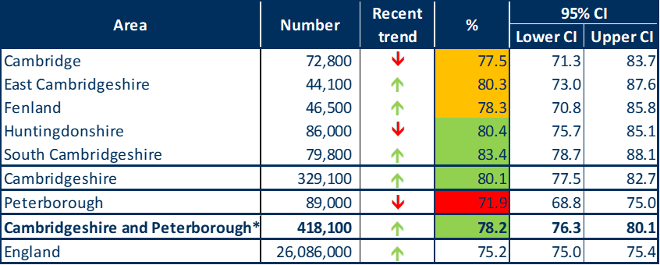
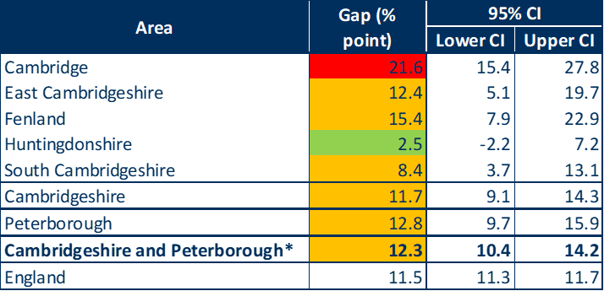
Employment
Employment: Percentage of people aged 16-64 in employment, 2017/18
Compared to the England average, Huntingdonshire has a statistically significantly higher (better) percentage of people in employment. However, the recent trend is a decline. This recent decline in employment is not found at the Cambridgeshire or England level.
The gap in the employment rate between those with a long-term health condition and the overall employment rate (ages 16-64 years), is statistically significantly better in Huntingdonshire, compared to England. This is the only Cambridgeshire district to have a better outcome for this indicator.
Source: PHE Public Health Outcomes Framework. (Table 26)
Employment gap* 2017/18
Source: PHE Public Health Outcomes Framework. (Table 27)
Notes:
*Gap in the employment rate between those with a long-term health condition and the overall employment rate (ages 16-64 years), 2017/18

Slide 13
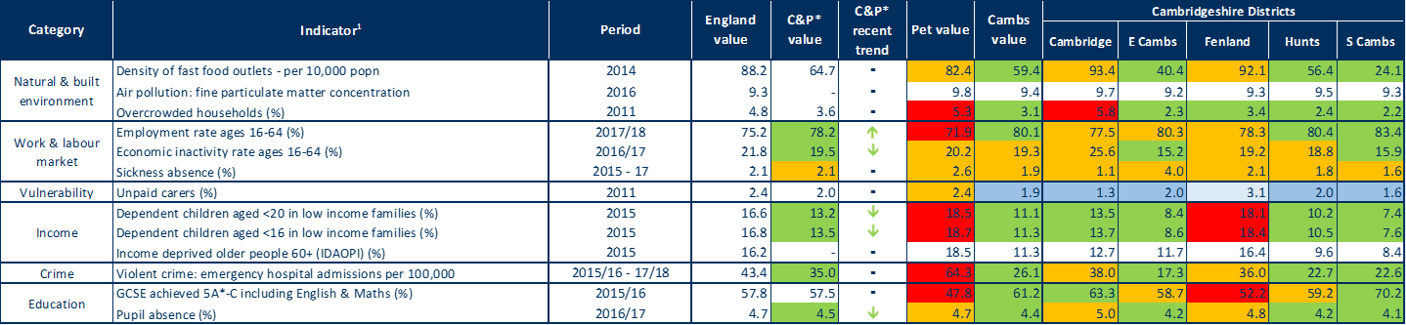
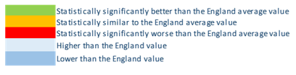
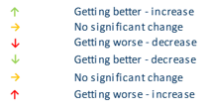
Other health determinants
Key indicators for wider health determinants
Overall, most wider health determinant indicators for Huntingdonshire are statistically significantly better than the England average.
Source: PHE Wider Determinants Atlas (Table 29)
The only three indicators where Huntingdonshire is statistically similar to then national average, and not statistically significantly better, are;
Work and labour market: Economic activity rate ages 16-64 (%)
Work and labour market: sickness absence (%)
GCSE achieved 5 A*-C including English and Maths (%)
Notes:
¹ Full indicator descriptions and definitions are available at https://fingertips.phe.org.uk/profile/wider-determinants
*Value aggregated from all known lower geography values

Slide 14
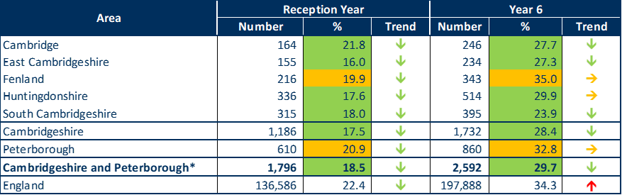
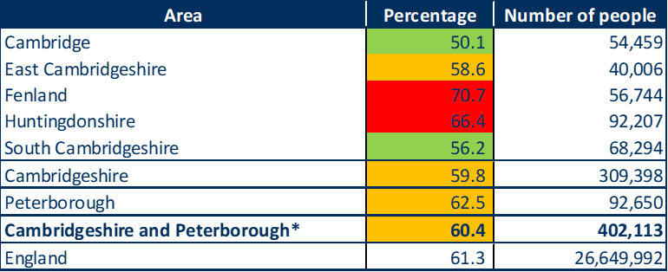
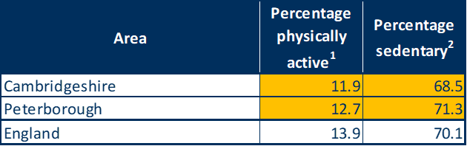
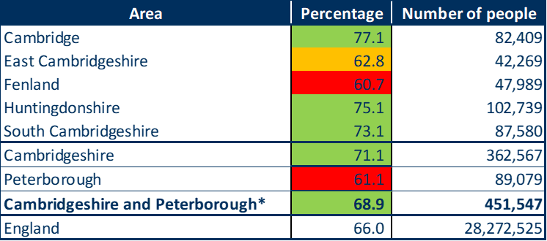

Excess weight and physical activity
Children (overweight or obese) 2017/18
Adults (18+) (overweight or obese) 2016/17
Huntingdonshire has statistically significantly better levels of excess weight in children and statistically significantly worse level of excess in adults than the England averages.
Huntingdonshire has a positive downward trend (‘getting better’) for excess weight in reception and Year 6 children.
Source: PHE Public Health Outcomes Framework Indicator 2.06 (National Child Measurement Programme, NHS Digital). (Table 30)
Sources: PHE Public Health Outcomes Framework Indicator 2.12
(Active People Survey, Sport England), ONS mid-2016 population estimates. (Table 31)
Physical activity in 15yr olds 2014/15
Physical activity in adults (19+) 2016/17
Levels of physical activity in 15 year olds in Cambridgeshire are statistically similar to England. Local data for Huntingdonshire were not available.
Levels of physical activity among adults in Huntingdonshire are statistically significantly higher than the national average.
Source: PHE, What About YOUth (WAY) Survey. (Table 34)
*Value aggregated from all known lower geography values
Sources: PHE Public Health Outcomes Framework Indicator 2.13 (Active People Survey, Sport England), ONS mid-2016 population estimates. (Table 35)
Notes:
Physical activity in 15yr olds 2014/15
Percentage of 15 year olds;
(1) physically active > one hour per day seven days a week
(2) with a mean daily sedentary time in the last week > 7 hours per day
Physical activity in adults (19+) 2016/17
Physical activity of adults defined as > 150 moderate intensity equivalent minutes per week.

Slide 15

Smoking
Smoking in adults, 2017
Smoking amongst 15 year olds is statistically similar in Cambridgeshire to the national average. 8.2% of 15 year olds in Cambridgeshire are current smokers¹ and 5.2% are regular smokers² (What about YOUth (WAY) survey) (data not shown).
    This includes regular smokers (>1 cigarette per week) and occasional smokers (smoke cigarettes sometimes)
    Regular smokers (>1 cigarette per week)
Smoking prevalence in adults in Huntingdonshire is statistically similar to the national average. At 14.0% this equates to around 19,600 people.
Smoking prevalence is higher in 18-64 year olds in routine and manual occupations than the total adult population in every area shown.
Sources: Annual Population Survey, (Adults 18+ - Public Health England PHOF indicator 2.14). (Table not in JSNA CDS)
Risks of certain conditions are increased by smoking.
In Huntingdonshire, the rate of deaths from lung cancer are statistically significantly lower than the rate nationally.
In Huntingdonshire, the rate of deaths from oral cancer and Chronic Obstructive Pulmonary Disease are statistically similar to the rate nationally.
Smoking related mortality, 2015-17
DASR – Directly Age Standardised Rate, COPD – Chronic Obstructive Pulmonary Disease
*Numbers too small to calculate DASR
Sources: ONS mortality data and Public health England based on ONS source data. (Table not in JSNA CDS)
Notes:
Source: What about YOUth (WAY) survey
1. Regular smokers (>1 cigarette per week) and occasional smokers (smoke cigarettes sometimes)
2. Regular smokers (>1 cigarette per week)

Slide 16
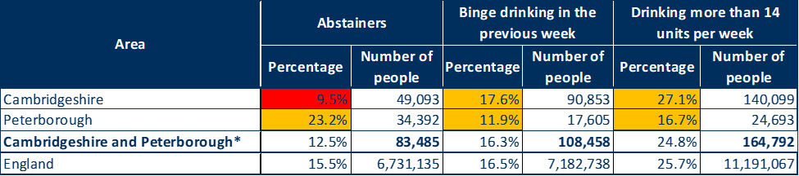
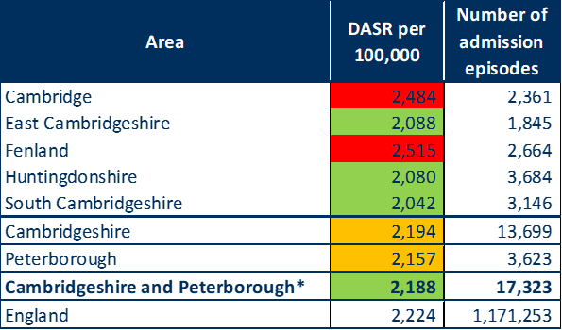
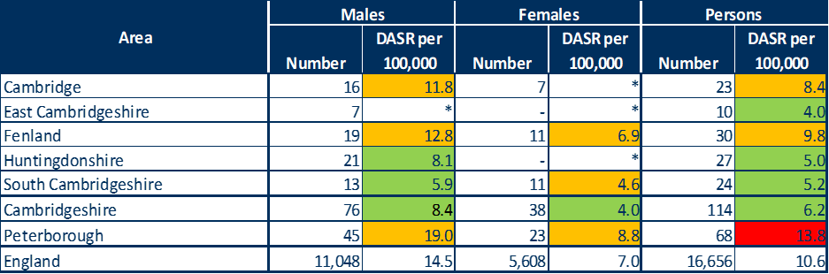

Alcohol
72.4% of 15 year olds in Cambridgeshire have ‘ever had an alcoholic drink’. This is statistically significantly worse than the England average. Levels of ‘regular drinkers’ are similar to levels nationally.*
*Public Health England, What About YOUth (WAY) Survey (data not shown, data in Table 40).
The percentage of Cambridgeshire adults who abstain from drinking alcohol is statistically significantly worse than the England average.
Huntingdonshire has a statistically significantly lower rate of alcohol-related hospital admission episodes than England.
Alcohol-specific mortality in Huntingdonshire is at a rate statistically significantly better than the national rate for males and persons (data for females is too small for calculations).
Drinking in adults (18+), 2011-14
Source: Public Health England Local Alcohol Profiles for England (Health Survey for England), ONS mid-year population estimates (Table 41).
Admission episodes for alcohol-related conditions (broad definition), 2017/18
Alcohol-specific mortality, 2015-17
* Value aggregated from all known lower geography values
DASR = directly age standardised rate.
*data too small for calculating, - Numbers too small to publish
Source: Calculated by Public Health England from the Office for National Statistics (ONS) Annual Death Extract Public Health Mortality File and ONS Mid Year Population Estimates (Table not in JSNA CDS).
Source: Public Health England Local Alcohol Profiles for England (Table 42)
Notes:
Admission episodes for alcohol-related conditions (broad definition), 2017/18
Alcohol-related conditions as primary or subsidiary cause of admission.
Broad definition is considered the best reflection of the burden of alcohol on the community and services.

Slide 17
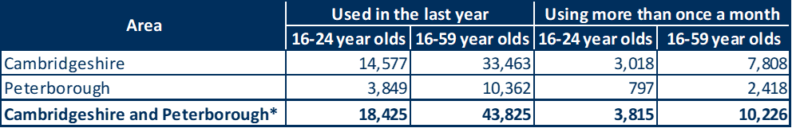
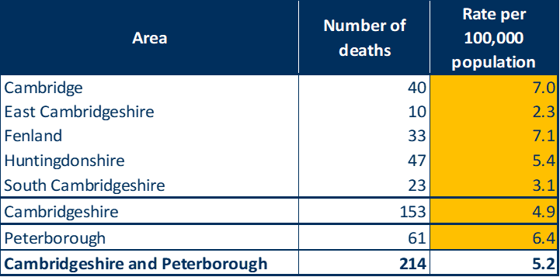

Drugs
Estimated numbers using any illegal~ drug, 2017
There are an estimated 33,500 people who have used drugs at least once in the last year in Cambridgeshire, around 7,800 of which use more than once a month.
Around 40 people die each year due to drug misuse in Cambridgeshire and Peterborough combined.
None of the area-based rates for drug-related mortality differ in terms of statistical significance compared to the Cambridgeshire/Cambridgeshire and Peterborough average.
~any drug controlled under the Misuse of Drugs Act 971
*Value aggregated from all known lower geography values
Source: Crime Survey for England 2017/18, ONS mid-17 population estimates (Table 45)
DASR Drug-related~ mortality, 2013-17
Note: Cambridgeshire districts are benchmarked against Cambridgeshire average, Cambridgeshire against C&P average, and Peterborough against C&P average
DASR = Directly Age-standardised rate
~any drug controlled under the Misuse of Drugs Act 971
Source: NHS Digital Primary Care Mortality Database (ONS) death registrations, ONS mid-year population estimates (Table 46)

Slide 18
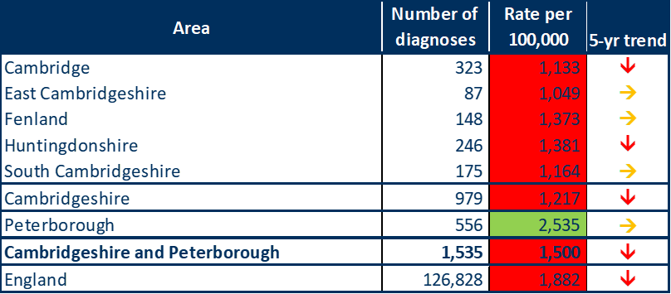





Sexual health
Chlamydia screening of 15-24yr olds is statistically significantly worse than the national benchmark for Huntingdonshire and the proportion screened has declined in recent years.
Chlamydia detection rates are low and decreasing in Huntingdonshire. Higher chlamydia detection rates are currently considered favourable as they are thought to reflect better control activity. However, low detection rates may also indicate low prevalence of infection in the population.
People diagnosed late with HIV have increased risk of mortality among those with HIV infection. HIV late diagnosis in Huntingdonshire is statistically significantly worse than the national benchmark.
Chlamydia screening % screened, 2017
Chlamydia detection rate per 100,000 aged 15-24, 2017
Source: Public Health England Public Health Profiles
Source: Public Health England Public Health Outcomes Framework indicator 3.02 (National Chlamydia Screening Programme) (Table 47)
Late HIV diagnosis, 2015-17
New STI diagnoses (exc chlamydia) in those aged 15-24yrs, 2017
The STI testing rate in Huntingdonshire is statistically significantly worse than the national average. Though the STI positivity rate is statistically similar to the national average, the recent trend is a decline.
Huntingdonshire has a recent increase in STI testing rate but a recent decline in positivity rates. This decline may indicate inappropriate targeting or a general decrease in prevalence of infection in the population.
Source: Public Health England
(Table not in JSNA CDS)
STI - sexually transmitted infection
Source: Public Health England Sexual and Reproductive Health Profiles (Table 48)
Compared to Benchmark
Notes:
Late HIV diagnosis, 2015-17
Late diagnosis is the most important predictor of morbidity and mortality among those with HIV infection. Those diagnosed late have a ten-fold risk of death compared to those diagnosed promptly.
Percentage of adults (aged 15 years or more) diagnosed with a CD4 cell count less than 350 cells per mm³ among all newly diagnosed adults with CD4 cell count available within 91 days of diagnosis.

Slide 19
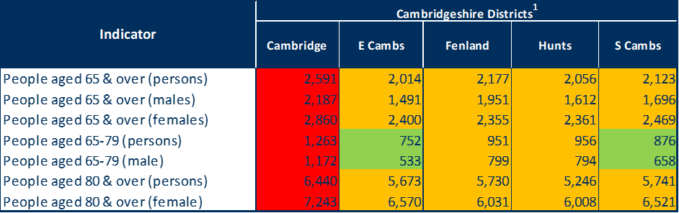
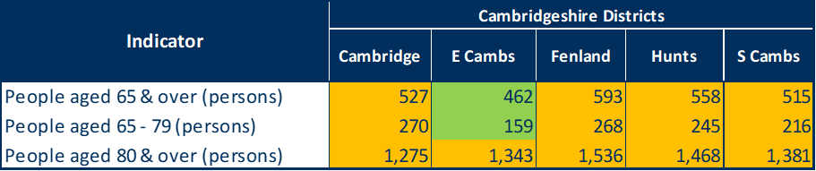

Falls and hip fractures
Falls in over 65s: Emergency hospital admissions (for age/sex groups where one or more districts have worse rates than England), 2017/18
For the age/sex groups where the Cambridge district is identified as statistically significantly worse than the England average, Huntingdonshire has a rate of emergency hospital admissions for falls that is statistically similar to the England average
Across Cambridgeshire and Peterborough the rates of hip fractures in people aged 65 and over tend to show no statistical difference to the England average; this is the case in Huntingdonshire.
Looking back to 2011/12 this pattern is similar with Cambridgeshire and most districts generally having rates that do not differ statistically from the England average (data not shown). However, the numbers of hip fractures are relatively small and this makes it harder to detect statistical differences.
¹ age standardised rate per 100,000 population
Source: Public Health England, Public Health Outcomes Framework (Table 50b)
Hip fractures in over 65s: emergency hospital admissions for fractured neck of femur, 2017/18
age standardised rate per 100,000 population
Source: Public Health England, Public Health Outcomes Framework (Table 51b)

Slide 20
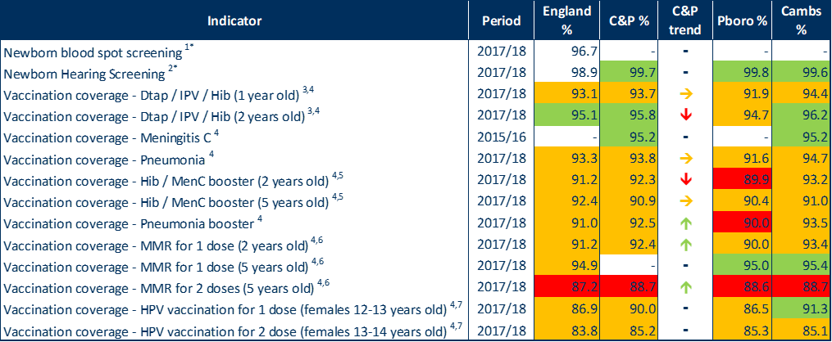
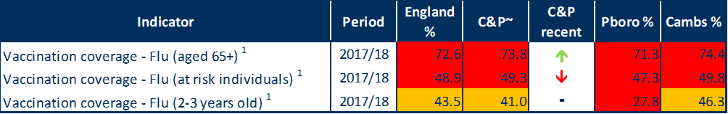
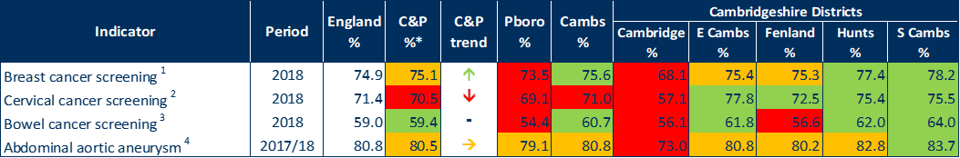
Screening
Childhood screening, vaccination and immunisation coverage
Childhood screening, vaccination and immunisation coverage data are not available at the Huntingdonshire district level.
For Cambridgeshire, levels of newborn hearing screening are better than the England average.
At a county level, generally Cambridgeshire has vaccination coverage levels that are similar to the target goals. There are some indicators where vaccination coverage is better than the benchmark goal.
For Cambridgeshire, and Peterborough, vaccination coverage rates for MMR for 2 doses (5 years old) are statistically significantly worse than the benchmark goals, as is England.
Flu vaccination coverage for older people and at risk individuals are statistically significantly below target goals for England and Cambridgeshire and Peterborough, both independently and as a whole.
In Huntingdonshire, the rates for breast, cervical and bowel cancer screening are statistically significantly better than the England average.
Abdominal aortic aneurysm screening rates are statistically similar to the England average in Huntingdonshire.
Cervical cancer screening has a downward trend nationally and locally.
Flu vaccination coverage
Screening coverage cancer and abdominal aortic aneurysm
Source: Public Health England, Public Health Outcomes Framework (Tables 52, 53, 54)
Notes:
Childhood screening, vaccination and immunisation coverage
Note:1 - % of babies eligible for newborn blood spot screening who were screened
Note:2 - % of babies eligible for newborn hearing screening for whom screening process is complete within 4 weeks
Note:3 - Vaccination - Dtap / IPV / Hib (1 year old) = diphtheria, hepatitis B, Hib (Haemophilus influenzae type b), polio, tetanus, whooping cough (pertussis).
Note:4 - benchmarked against threshold based goals - see http://www.phoutcomes.info/
Note:5 - Hib = Haemophilus influenzae type b; MenC = meningitis C
Note:6 - MMR = measles, mumps and rubella
Note:7 - HPV = Human papilloma virus
Data not available
Flu vaccination coverage
¹ benchmarked against threshold based goals
-No recent trend data available
~ Aggregated from all known lower geography values
At risk individuals defined as - People aged 6 months to 64 years with certain medical conditions, excluding otherwise healthy pregnant women and carers.
Screening coverage
Note: ¹ - % of eligible women screened adequately within the previous 3 years on 31st March
Note: ² - % of eligible women screened adequately within the previous 3.5 or 5.5 years (according to age) on 31st March
Note: ³ - % of people eligible for bowel screening who were screened
Note: ⁴ - % of men eligible for abdominal aortic aneurysm screening who are conclusively tested
* Aggregated from all known lower geography values, not statistically assessed
- Recent trend not available

Slide 21
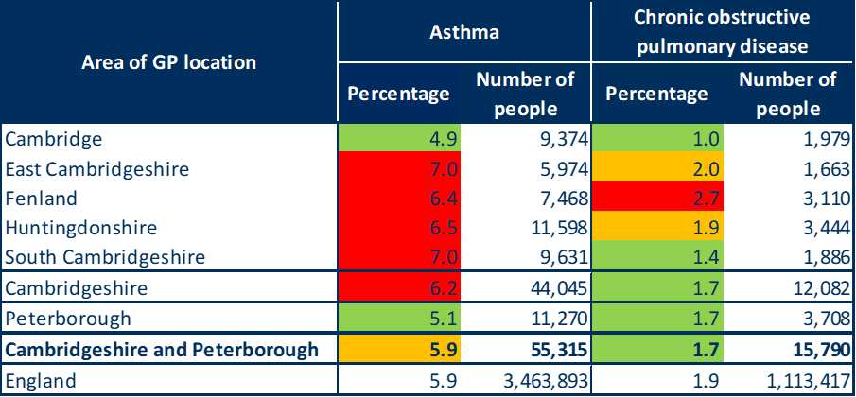
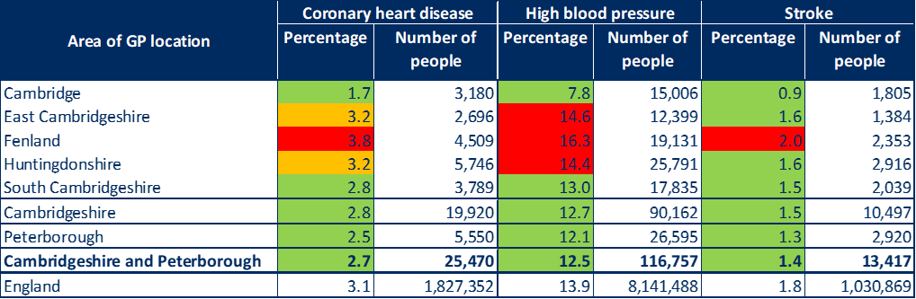
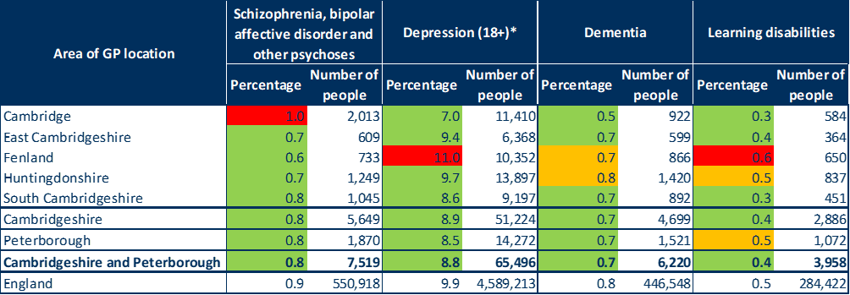
Illness in the population – disease and condition prevalence
Respiratory 2017/18
Cardiovascular 2017/18
For stroke and diabetes the prevalence in Huntingdonshire is statistically significantly lower than found nationally.
For asthma, high blood pressure, and cancer, the prevalence in Huntingdonshire is higher than the England averages.
In terms of mental health conditions in Huntingdonshire, rates of Schizophrenia, bipolar affective disorder, and other psychoses, and depression, are at levels statistically significantly lower than England averages. Rates of dementia and learning disabilities are statistically similar to national averages.
Long-term conditions 2017/18
Mental health conditions 2017/18
* Patients diagnosed with cancer (excluding non-melanotic skin cancer) on or after 01/04/2003
* Patients with a record of unresolved depression since April 2006
Sources: NHS Digital, Quality and Outcomes Framework, CCC Public Health Intelligence (Tables 55, 60, 63 ,and 66)

Slide 22
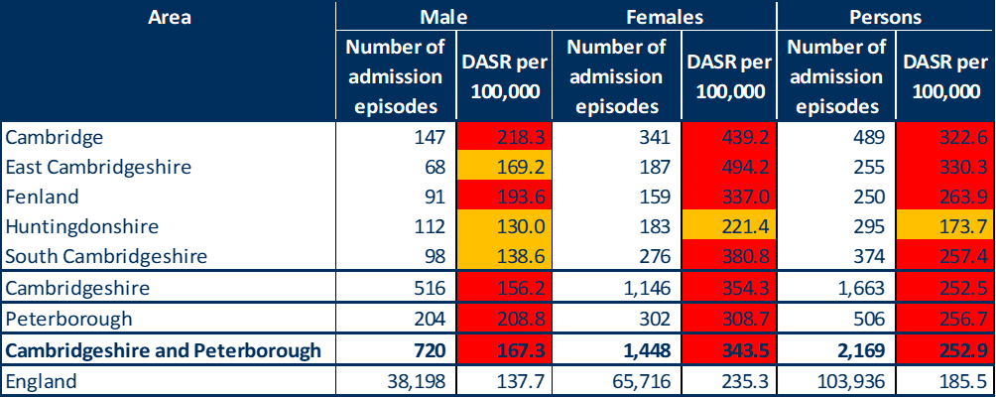
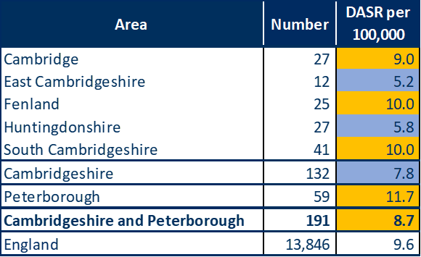

Self-harm and suicide
Emergency hospital admission episodes for intentional self-harm, 2017/18
Self-harm appears to be a particular issue across Cambridgeshire and Peterborough combined, independently, and across most of the Cambridgeshire districts. There are sustained high rates of emergency hospital admissions and levels above the national average in all districts other than Huntingdonshire. Rates are higher in females than males.
The directly age-standardised rate of admissions episodes for self-harm in Huntingdonshire is 173.7 per 100,000 persons. For females, this increases to a rate of 221.4 per 100,000.
The rates of suicides for Cambridgeshire and Peterborough as a whole, as well as Peterborough, do not differ significantly from the rate for England. Cambridgeshire’s suicide rate is statistically significantly lower than the national rate.
Suicide rates in males are higher than in females (data not shown).
In 2015/17 there were 27 recorded suicides in Huntingdonshire. The rate of suicides for Huntingdonshire is statistically significantly lower than the rate for England.
DASR – Directly age-standardised rate
Source: Public Health England Public Health Outcomes Framework indicator 2.10ii (Table 71)
Suicide* (persons), 2015-17
Source: Public Health England Public Health Outcomes Framework indicator 4.10 (Table 72)
*suicide and injury of undetermined intent

Slide 23
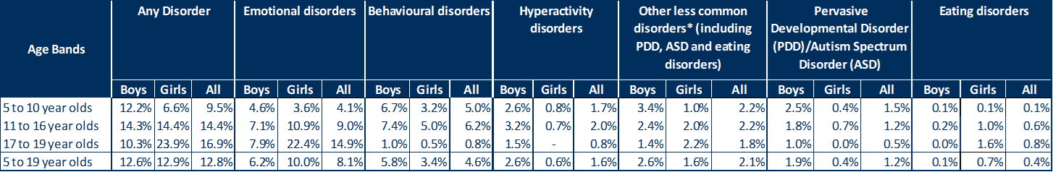
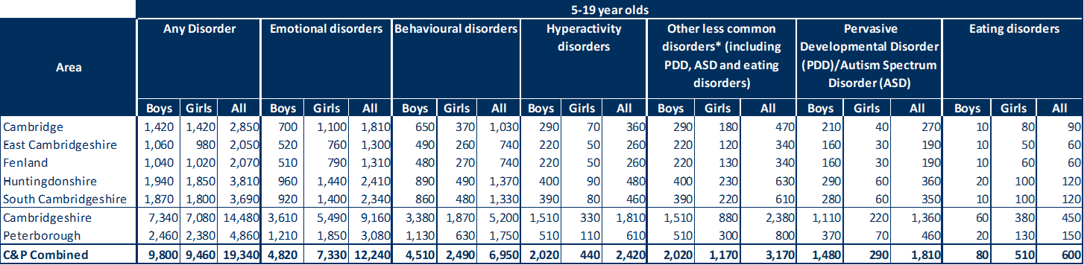
Mental health in children and young people
Mental Health of Children and Young People (c&yp) in England, 2017, published by NHS Digital, collected information from 9,117 c&yp. This table (right) shows the findings on the prevalence of mental disorder by broad categories. Prevalence is applied to population estimates to produce local estimates of those experiencing mental health disorders (table below).
One in eight (12.8%) 5 to 19 year olds had at least one mental disorder when assessed (equivalent to approx. 3,810 c&yp in Huntingdonshire).
Emotional disorders were the most prevalent of the disorders (8.1%) (equivalent to approx. 2,410 c&yp in Huntingdonshire).
Different disorders were prominent at different stages of childhood.
Any mental health disorder and specific disorders prevalence by age and sex, 2017
Note: *Other less common disorders, includes PDD, ASD, eating disorders and Tics/other less common disorders. ‘-‘ = no observations (zero value)
Source: Mental Health of Children and Young People Survey, NHS Digital Copyright © 2018 Health and Social Care Information Centre (Table 73)
Estimated number of children and young people (aged 5-19yrs) with a mental health disorder
Source: Mental Health of Children and Young People Survey, NHS Digital Copyright © 2018 Health and Social Care Information Centre applied to ONS Mid-2017 Local Authority District and County population estimates (Table 74)
Notes:
Note: *Other less common disorders, includes PDD, ASD, eating disorders and Tics/other less common disorders
‘-‘ = no observations (zero value)
Caution is needed, when comparing rates between age groups due to differences in data collection. For example, teacher reports were only available for 5 to 16 year olds. For further details see Survey Design and Methods report
https://files.digital.nhs.uk/22/793517/MHCYP%202017%20Survey%20Design%20and%20Methods.pdf

Slide 24
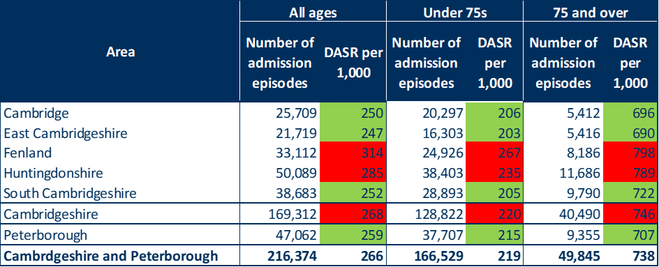
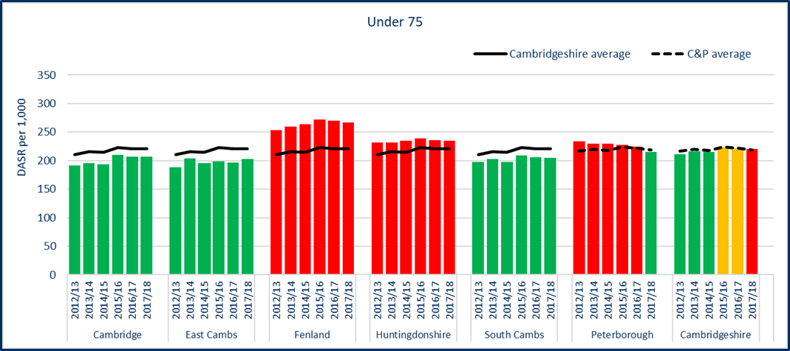
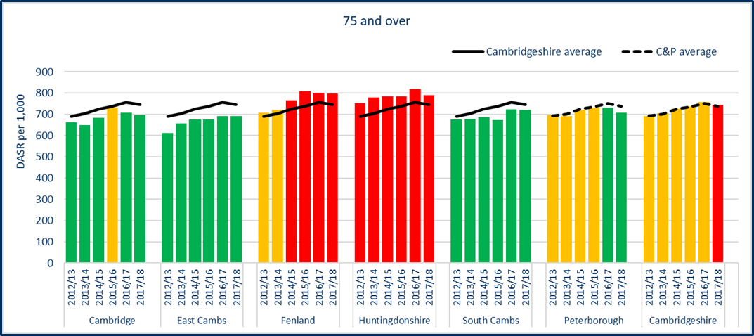
Hospital admissions – all inpatient admissions
All hospital inpatient admission episodes by area of residence, 2017/18
There were a total of 50,089 inpatient admission episodes for Huntingdonshire in 2017/18 (30% of Cambridgeshire’s total).
Numbers of inpatient hospital admission episodes have slightly decreased among Under 75 residents of Huntingdonshire since the previous year (data not shown).
The rate of inpatient admission episodes is statistically significantly worse than the Cambridgeshire average in Huntingdonshire in all ages combined, under 75s and 75s and over. This has been consistent in recent years.
Rates of inpatient admission episodes are more than three times higher in people aged 75 and over than in under 75s for Huntingdonshire. A similar ratio is also recorded for the other C&P CCG areas.
For the table and two graphs shown:
DASR - directly age-standardised rate.
Includes all elective, emergency, maternity and other admissions (excluding well babies receiving usual care).
Cambridgeshire districts are benchmarked against Cambridgeshire average value, Cambridgeshire against C&P average value, and Peterborough against C&P average value.
DASR of hospital inpatient admission episodes by area of residence, 2012/13 to 2017/18
Sources: NHS Digital Hospital Episode Statistics, ONS mid-year population estimates (Table 78 and Figure 37)

Slide 25
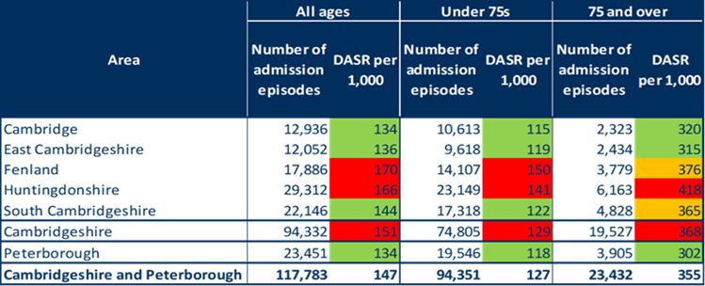
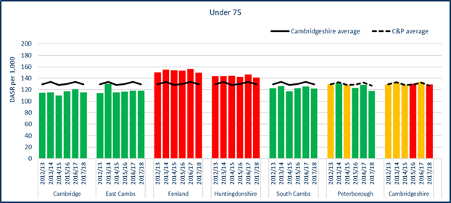
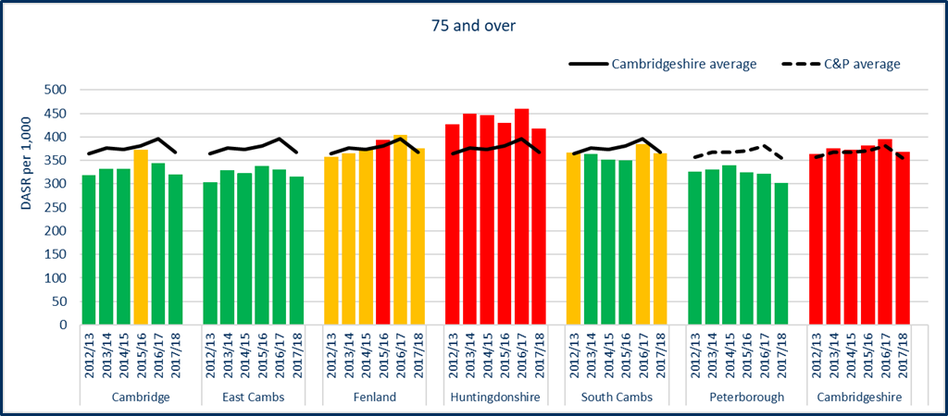
Hospital admissions – elective (planned) inpatient admissions
Elective hospital inpatient admission episodes by area of residence, 2017/18
There were a total of 29,312 elective inpatient admission episodes for Cambridge in 2017/18 (31% of Cambridgeshire’s total).
Numbers of elective inpatient hospital admission episodes have decreased among residents of Huntingdonshire since the previous year (data not shown).
The rate of elective inpatient admission episodes is statistically significantly worse than the Cambridgeshire average in Huntingdonshire in all ages combined, under 75s and 75s and over. This has been consistent in recent years.
Rates of elective inpatient admission episodes are more than 2.5 times higher in people aged 75 and over than in under 75s for Huntingdonshire. Elective admissions for this age group are substantially higher for all areas shown.
For the table and two graphs shown:
DASR - directly age-standardised rate.
Cambridgeshire districts are benchmarked against Cambridgeshire average value, Cambridgeshire against C&P average value, and Peterborough against C&P average value.
DASR of elective hospital inpatient admission episodes by area of residence, 2012/13 to 2017/18
Sources: NHS Digital Hospital Episode Statistics, ONS mid-year population estimates (Table 79 and Figure 39)

Slide 26
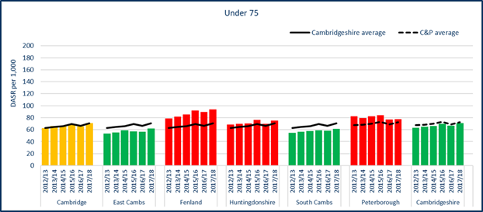

Hospital admissions – emergency inpatient admissions
Emergency hospital inpatient admission episodes by area of residence, 2017/18
There were a total of 17,732 emergency inpatient admission episodes for Huntingdonshire in 2017/18 (28% of Cambridgeshire’s total).
Numbers of emergency inpatient hospital admission episodes have increased among residents of Huntingdonshire since the previous year, particularly among the under 75 age group (data not shown).
The rate of emergency inpatient admission episodes is statistically significantly worse than the Cambridgeshire average in Huntingdonshire in all ages combined and under 75s. Rates for 75 and overs are statistically similar to the Cambridgeshire average.
Rates of emergency inpatient admission episodes are almost five times higher in people aged 75 and over than in under 75s for Huntingdonshire. Emergency admissions for this age group are substantially higher for all areas shown.
For the table and two graphs shown:
DASR - directly age-standardised rate.
Cambridgeshire districts are benchmarked against Cambridgeshire average value, Cambridgeshire against C&P average value, and Peterborough against C&P average value.
DASR of emergency hospital inpatient admission episodes by area of residence, 2012/13 to 2017/18
Sources: NHS Digital Hospital Episode Statistics, ONS mid-year population estimates (Table 80 and Figure 41)

Slide 27



Accident and Emergency (A&E) attendances
There were 46,944 A&E attendances for Huntingdonshire residents in 2017/18 (23% of Cambridgeshire’s total).
Numbers of A&E attendances have slightly increased among residents of Huntingdonshire since 2016/17 (data not shown).
In Huntingdonshire, the rate of A&E attendances is statistically significantly better than the Cambridgeshire average for all A&E departments and minor injuries units, but statistically similar to the Cambridgeshire average for 24-hr consultant-led A&E provision. This may be in part due to the proximity of local services.
For Cambridgeshire and Peterborough combined;
Rates of attendance at 24-hour A&E are statistically significantly higher than the all-age average in young children (0 and 1-4 years), young adults (15-29yrs), and in older people aged 70 and over (data not shown).
Rates of attendance at minor injuries units are statistically significantly higher than the all-age average in children and young adults, ages 0-34 (data not shown).
For the table and two graphs shown:
DASR - directly age-standardised rate.
‘All departments’ includes 24-hour consultant led departments, consultant-led single specialty services, doctor- or nurse-led minor injuries units, walk-in centres and where type is unknown.
Cambridgeshire districts are benchmarked against Cambridgeshire average value, Cambridgeshire against C&P average value, and Peterborough against C&P average value.
A&E attendances by area of residence and department type, 2017/18
DASR of accident and emergency attendances by area of residence, 2012/13 to 07/18
Sources: NHS Digital Hospital Episode Statistics, ONS mid-year population estimates (Table 81 and Figure 44)

Slide 28


Social care - adults
Number of people receiving long term support 2017/18
In Huntingdonshire, 1,930 people aged 18+ were receiving long term support from adult social care services in 2017/18.
The majority of people receiving long term support are aged 65+ (1,355 of the 1,930). This trend is also shown across the Cambridgeshire and Peterborough authorities.
The number of people receiving long term support per 100,000 population aged 18+ is higher in Huntingdonshire compared to other local areas. All district areas within Cambridgeshire have a rate lower than England (1,960 per 100,000 – data not shown).
In Huntingdonshire, 960 carers were supported by adult social care services in 2017/18. This is a rate of 684 per 100,000 population aged 18+ and is lower than the Cambridgeshire average (the rate for England is 825 per 100,000 – data not shown).
Number of carers supported 2017/18
Note: *Cambridgeshire district percentages relate to Cambridgeshire total and Cambridgeshire and Peterborough percentages relate to Cambridgeshire and Peterborough Combined Authority total
Source: NHS digital and ONS (see notes). (Tables 89 and 90)
Notes:
Adults social care data sources:
Population data
ONS population data was used to calculate rates per 10,000 and 100,000 population at a council and district geographies
https://www.ons.gov.uk/peoplepopulationandcommunity/populationandmigration/populationestimates/datasets/populationestimatesforukenglandandwalesscotlandandnorthernireland
Adult social care data
National, Regional, and statistical neighbour datasets were obtained from the NHS Digital website:
https://app.powerbi.com/view?r=eyJrIjoiNTY0ZTNhN2YtODg2ZS00OTIyLWI2MjItZTJiY2E5M2MxNTBmIiwidCI6IjUwZjYwNzFmLWJiZmUtNDAxYS04ODAzLTY3Mzc0OGU2MjllMiIsImMiOjh9

Slide 29




Social care - children
In 2017/18 there were 1,107 children’s social care referrals from Huntingdonshire. This is a rate of 302.6 per 10,000 population aged 0-17 years and is numerically lower than the Cambridgeshire average. (Referral rate for England is 552.50 per 10,000 – data not shown). Children’s social care referrals in Huntingdonshire account for 25% of the Cambridgeshire total.
The number of children in need in Huntingdonshire supported on 31 March 2018 was 754. This is a rate of 206.1 per 10,000 population aged 0-17 years and is numerically lower than the Cambridgeshire average. (Referral rate for England is 341.0 per 10,000 – data not shown). Children in need referrals in Cambridge account for 21% of the Cambridgeshire total.
The number of children with a child protection plan open in Huntingdonshire on 31 March 2018 was 88. This is a rate of 24.1 per 10,000 population aged 0-17 years and is the second lowest rate compared to the other Cambridgeshire districts. Children with a protection plan in Huntingdonshire account for 18% of the Cambridgeshire total.
In 2017/18 there were 165 looked after children in Huntingdonshire. This is a rate of 45.1 per 10,000 population aged 0-17 years and is numerically lower than the Cambridgeshire average. Looked after children in Huntingdonshire account for 23% of the Cambridgeshire total.
Children's social care referrals received 2017/18
Children in need supported (31 March 2018)
Children with a child protection plan (31 March 2018)
Looked after children 2017/18
Note: *Cambridgeshire district percentages relate to Cambridgeshire total and Cambridgeshire and Peterborough percentages relate to Cambridgeshire and Peterborough Combined Authority total
Source: Department for Education and Cambridgeshire Children’s Social care statutory returns (see notes)
(Tables 83, 84, 86 and 87)
Notes:
Children in Need 31 March 2018
A child in need is defined under the Children Act 1989 as a child who is unlikely to achieve or maintain a reasonable level of health or development, or whose health and development is likely to be significantly or further impaired, without the provision of services, or a child who is disabled (Children Act 1989)
Looked after children 2017/18
Under the Children Act 1989, a child is looked after by a local authority if he or she falls into one of the following:
is provided with accommodation, for a continuous period of more than 24 hours, [Children Act 1989, Section 20 and 21]
is subject to a care order [Children Act 1989, Part IV]
is subject to a placement order (SSDA903 guidance, 2018)
Children’s social care data sources:
Actual numbers (e.g. total number of Children’s Social Care referrals per local authority) were taken from the main DfE statistical release, published December 2018
https://assets.publishing.service.gov.uk/government/uploads/system/uploads/attachment_data/file/762539/Characteristics_of_children_in_need_2017-2018_Main_tables.xlsx
District level data was obtained from the Cambridgeshire Children’s Social care statutory returns – CiN Census and SSDA903 LAC return
https://www.gov.uk/government/publications/children-looked-after-return-2017-to-2018-guide
https://www.gov.uk/government/publications/children-in-need-census-2017-to-2018-guide

Slide 30



Life expectancy
Life expectancy and gap in life expectancy (at birth) 2015-17
Life expectancy (at birth) is 81.3 years for males and 84.6 years for females in Huntingdonshire. The life expectancy for males and females is statistically significantly higher than the England average.
The gap in life expectancy between the least and most deprived areas is lower than the Cambridgeshire average for men in Huntingdonshire.
Healthy life expectancy data is not available at the Huntingdonshire district level.
The number of years lived in good health (healthy life expectancy at birth) is statistically significantly higher than the England average in females in Cambridgeshire.
The number of years lived in good health (healthy life expectancy at birth) is statistically similar to the England average in males in Cambridgeshire.
* Slope index of inequality, LE – Life expectancy
Source: ONS, Public Health England Public Health Outcomes Framework indicators 0.1ii and 0.2iii (Table 94)
Healthy life expectancy at birth 2015-17
Source: ONS (Table 95)
Notes:
Life Expectancy
Life expectancy at birth is the average number of years that a baby born in a particular area can expect to live should they experience the current age-specific mortality rates of the area throughout life. Average life expectancy represents the cumulative effect of the prevalence of risk factors, prevalence and severity of disease, and the effectiveness of interventions and treatment across the life course.
Note - benchmarking and statistical significance: Tables that are ‘Red-Amber-Green’ (RAG) rated use confidence intervals to derive the statistical significance of differences of areas compared with a benchmark, e.g. England. This gives the RAG rating. Cambridgeshire and Peterborough PHI Team calculate statistical significance using comparator area confidence intervals compared with confidence intervals for the benchmark. This method is used in the RAG rated NHS Digital Primary Care Mortality Database tables in this section. Public Health England (PHE) calculate statistical significance using comparator area confidence intervals compared with the area value for the benchmark. This method is used in the RAG rated PHE tables in this section. Therefore PHI calculated benchmarking may differ from PHE calculations.

Slide 31


Overall health status
Directly age-standardised percentage of the population reporting good or very good health, 2011
84.2% of household residents in Cambridgeshire reported good or very good health in the 2011 Census. The percentage varied by age, from 97.7% in 0-15s to 31.1% in 85s and over, and by sex, with a slightly lower percentage in females than males (data not shown).
After adjusting for age (as shown here), the percentage reporting good or very good health was statistically significantly lower than the England average in Peterborough and Fenland but statistically significantly higher in Huntingdonshire, the other districts, and for Cambridgeshire as a whole.
At electoral ward level (2011 wards), the age-standardised percentage reporting good or very good health was statistically significantly lower than the Cambridgeshire average in the Huntingdonshire ward of Huntingdon North.
Cambridgeshire and Peterborough, by district
Cambridgeshire, by ward
Usual residents in households only (i.e. excluding communal establishments such as hospitals and care homes)
Source: ONS Census 2011, Cambridgeshire County Council Public Health Intelligence (Figures 67 and 68)

Slide 32


Long-term limiting illness (LTLI)
Directly age-standardised percentage of the population with an LTLI, 2011
90,420 people (15.1% of household residents in Cambridgeshire) reported a long-term activity-limiting illness in the 2011 Census. The percentage varied by age, from 3.5% in 0-15s to 82.7% in 85s and over. The percentage also varied by sex, with generally higher percentages in females than males (data not shown).
After adjusting for age (as shown here), the percentage with a long-term activity-limiting illness was statistically significantly higher than the England average in Peterborough and Fenland but statistically significantly lower in Huntingdonshire, the other districts, and for Cambridgeshire as a whole.
At electoral ward level (2011 wards), the age-standardised percentage reporting a long-term activity-limiting illness was statistically significantly higher than the Cambridgeshire average in the Huntingdonshire wards of Huntingdon East, Huntingdon North, Ramsey, St Neots Eaton Socon, St Neots Eynesbury and Yaxley and Farcet.
Cambridgeshire and Peterborough, by district
Cambridgeshire, by ward
Usual residents in households only (i.e. excluding communal establishments such as hospitals and care homes)
Source: ONS Census 2011, Cambridgeshire County Council Public Health Intelligence (Figures 70 and 71)

Slide 33





Mortality
In 2015-17 major causes of death in Cambridgeshire and Peterborough were Cancer (28%), Cardiovascular disease (25%), Respiratory disease (13%), and Dementia and Alzheimer's (12%) (further information can be found in Table 111 in full report).
In Huntingdonshire
  the rates of all-age all-cause mortality is statistically significantly better than the Cambridgeshire average. The rate for under 75s is statistically similar.
  the rates of mortality from cardiovascular disease are statistically similar to the Cambridgeshire average for all-ages and under 75s.
  the rates of all-age and under 75 cancer mortality are statistically similar to the Cambridgeshire average.
  the rates of mortality from respiratory disease are statistically significantly worse than the Cambridgeshire average for all-ages, and statistically similar to the Cambridgeshire average for under 75s.
  the rates of mortality from dementia and Alzheimer’s are statistically similar to the Cambridgeshire average for all-ages and under 75s.
All-cause mortality 2015-17
from cardiovascular disease 2015-17
from cancer 2015-17
from respiratory disease 2015-17
from dementia and Alzheimer’s 2015-17
For all tables shown:
DASR - Directly age-standardised rate
Cambridgeshire districts are benchmarked against Cambridgeshire average, Cambridgeshire against C&P average, and Peterborough against C&P average
Source: Cambridgeshire County Council Public Health Intelligence (NHS Digital Primary Care Mortality Database, ONS mid-year population estimates). (Table 96, 112, 115, 118, and 121)

Slide 34
Future disability and disease
POPPI and PANSI tools produce data on expected future numbers of individuals with certain conditions. These figures are then applied to ONS and CCCRG population estimates for Cambridgeshire and Peterborough in the tables shown.
For Huntingdonshire, based on CCCRG future population estimates (which consider local growth plans in their methodology so are assumed to be more accurate), the predicted increases 2017-2035 in those experiencing certain conditions are:
  Moderate physical disability: 9.2%
  Serious physical disability: 9.8%
  Mod/Serious personal care disability: 9.3%
  Common mental disorder: 9.8%
  A fall: 72.9%
  Dementia: 109.3%
Additional need will add additional demand on service provision.
Numerically, the estimated change in the proportion of people experiencing a fall or dementia, 2017-2035, are numerically higher in Huntingdonshire than the Cambridgeshire average.
Population (aged 18-64yrs) predicted to have a moderate physical disability, 2017-2035 (% change)
Population (aged 18-64yrs) predicted to have a serious physical disability, 2017-2035 (% change)
Population (aged 18-64yrs) predicted to have a moderate or serious personal care disability, 2017-2035 (% change)
Population (aged 18-64yrs) predicted to have a common mental disorder, 2017-2035 (% change)
Population (aged 65+ yrs) predicted to have a fall, 2017-2035 (% change)
Population (aged 65+ yrs) predicted to have dementia, 2017-2035 (% change)
Source: Projecting Older People Population Information (POPPI), Projecting Adult Needs & Service Information (PANSI) & Cambridgeshire County Council Research Group (CCCRG) Population Data & Projections (Tables 100,102, 104, 106, 108 and 110)

Slide 35
Further information
The Cambridgeshire and Peterborough JSNA Core Dataset was first produced in 2018, following an initial Cambridgeshire JSNA Core Dataset and Peterborough JSNA Core Dataset produced by Cambridgeshire County Council and Peterborough City Council’s Public Health Intelligence team in 2017.
All of the JSNA Core Datasets are available at
  http://cambridgeshireinsight.org.uk/jsna
  and www.peterborough.gov.uk/healthcare/public-health/JSNA.
For more information please contact the Public Health Intelligence team at:
  Cambridgeshire at PHI-team@cambridgeshire.gov.uk and Peterborough at phi-team@peterborough.gov.uk.

