Slide 1
Cambridge City Foodbank
Advocacy plans

Slide 2
CCFB Survey
Conducted for month of October
Five questions
Thirty six multiple choice answers
Goal of Survey:
Are people getting to the right services they need
What extra services would they find helpful
46 forms returned

Slide 3
1. Before you accessed the foodbank can you describe some of the challenges you face that contributed to your need for help with food supplies?

Slide 4
2. Can the organisation that gave you the Food bank voucher help you fix the problems you are facing at the moment?

Slide 5
3. How do you look for organisations that can give you help?

Slide 6
4. The Food bank is thinking about ways to give help in other problem areas. If we did this would you be interested?

Slide 7
2017/18 Strategic Objectives
Establish Advocacy Team
New team of volunteers focussed on signposting
Team to help at distribution centres offering information and support to clients
Establish IT support centre where feasible at distribution centres
Online information centre
Access to benefit calculators
Phone contact to support agencies
Grant applications
Provide added value without disrupting existing foodbank operation

Slide 8
Goals
A volunteer present at every distribution centre with enhanced knowledge and skills for referral and assistance
NOT and advice agency but able to work to understand client needs and connect to appropriate support agency
NOT undermining existing support agency
Have phone to enable immediate referral
Have internet access and knowledge of support tools
Support other agencies having a presence if appropriate
Have ongoing relationship with client if appropriate

Slide 10
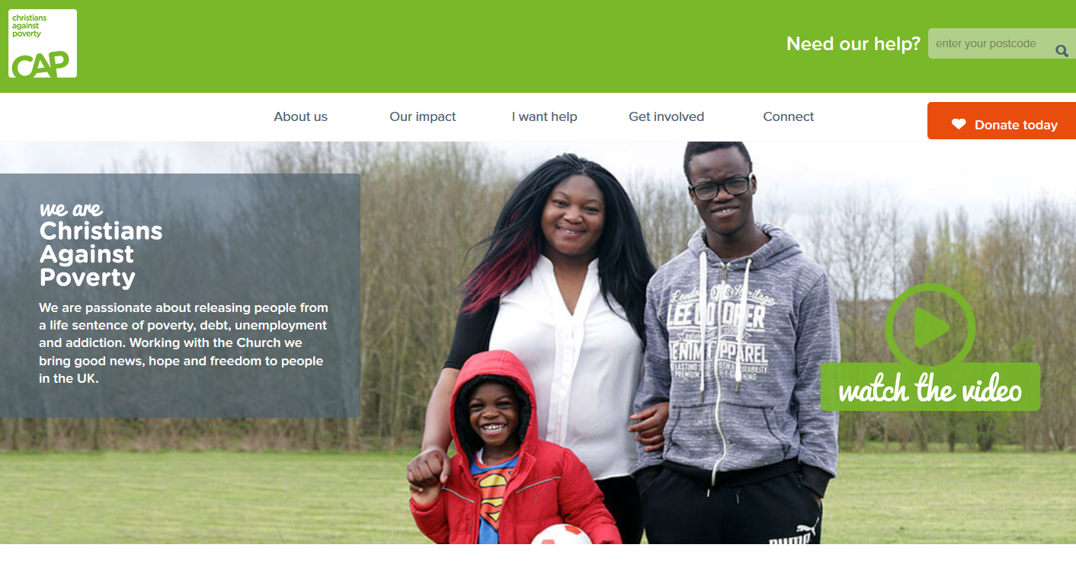

Slide 12
Proposed Partnership with Cambridge CAB
A new, dedicated part-time (three days a week) Foodbank/CAB Supervisor will:
provide the initial intensive training needed by volunteers
carry out joint monthly supervision sessions for volunteers with the Foodbank Co-ordinator
provide day to day support to volunteers when they are providing information/advice
provide regular refresher training sessions to ensure the Foodbank volunteer team is giving the very latest information and advice based on most recent legislation and best practice.
Cambridge CAB will also work with the team to:
deliver financial capability training to Foodbank users who lack financial skills,
build strong partnerships with key organisations to whom the volunteers can refer clients when they need specialist help and
support and help the team to build a range of high level information resources which they can share with Foodbank service users that will help users to manage their own issues themselves in future.

Slide 13
Why now?
Foodbank is operating well. We can invest energy in new initiatives
There is a realisation nationally that foodbanks are well positioned to help people to get back on track. Food provides survival but we want to point people in the right direction
There is an increase in online support resources that may be hard for clients to access without help

Slide 14
Feedback?

